Slide 1
Scalar Fields in Action
IF.USP.SCarlos, November, 2012
Dionisio Bazeia
DF - UFPB/IF - USP

Slide 2
Scalar Fields in Action Summary
One-field models
Deformation
Two-field models
Compact solutions
Twin-like models
Braneworld
Cosmology

Slide 3
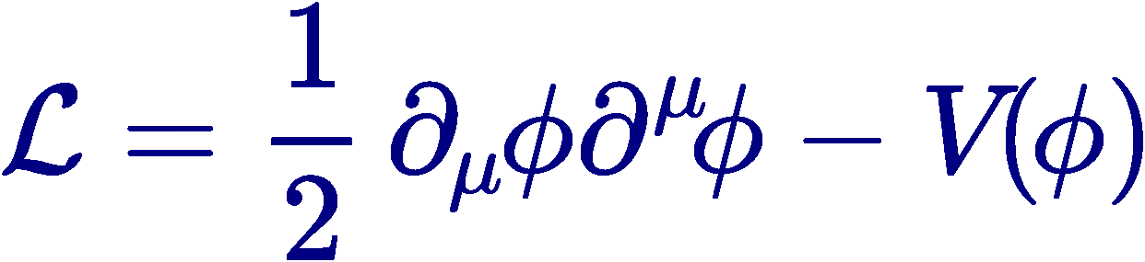
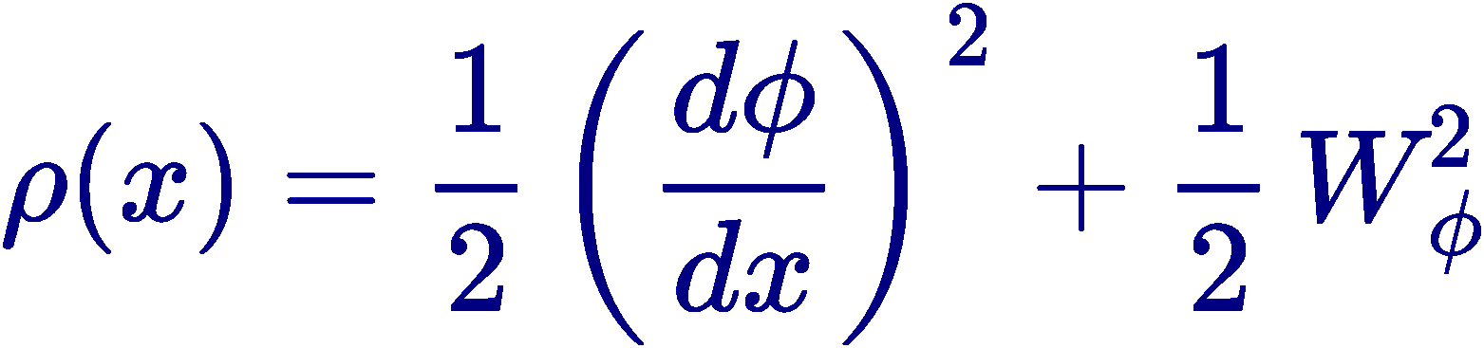
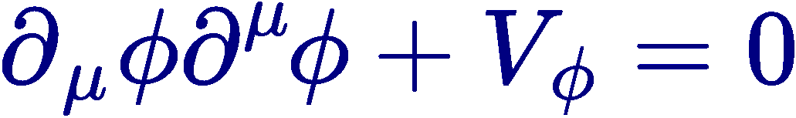
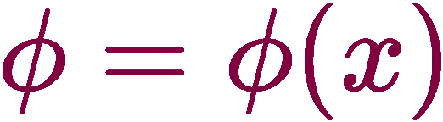
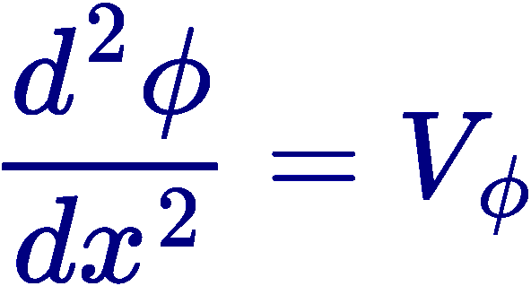
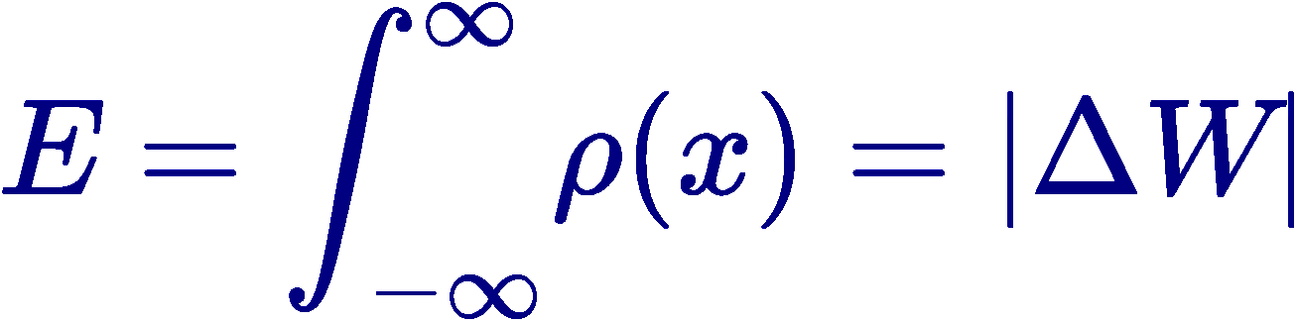
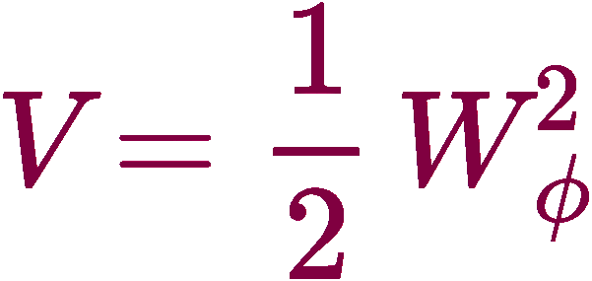
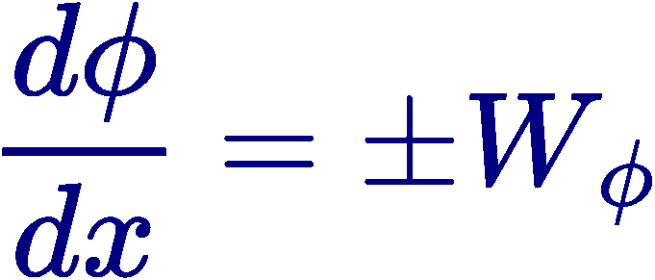
Scalar Field Models
One Field
    Equation of Motion
    Static Solutions
    Topological solutions
    Energy Density
    Energy

Slide 4


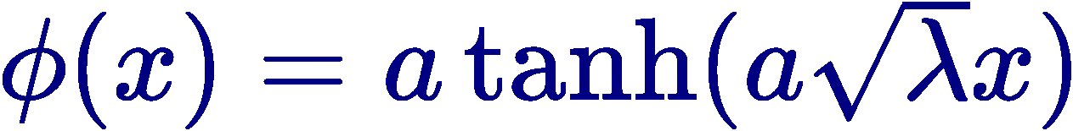
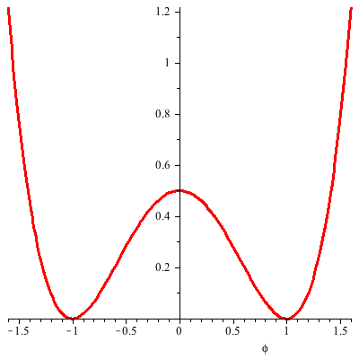
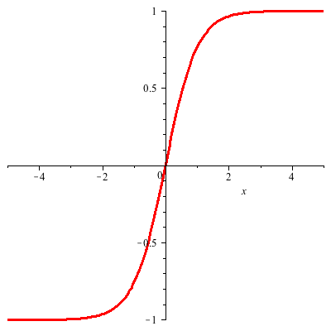
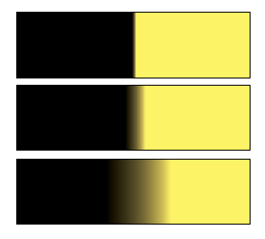
One Field
Quartic Potential
    Two Parameters: amplitude and width

Slide 5
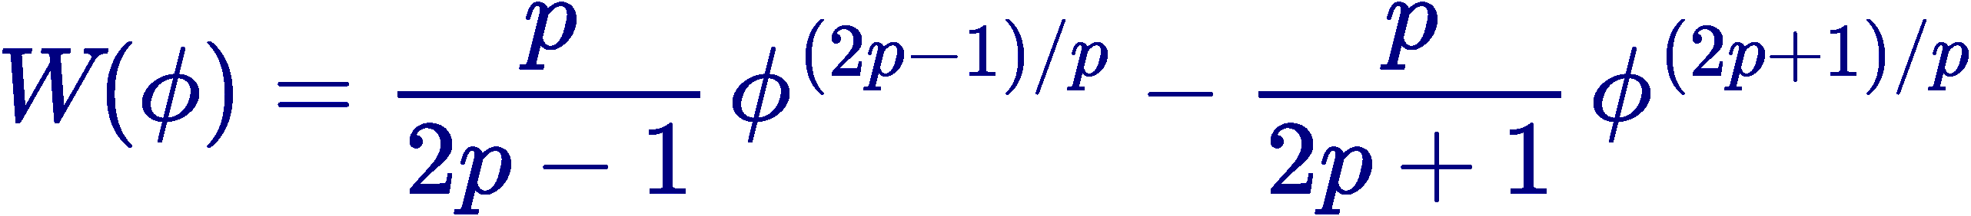
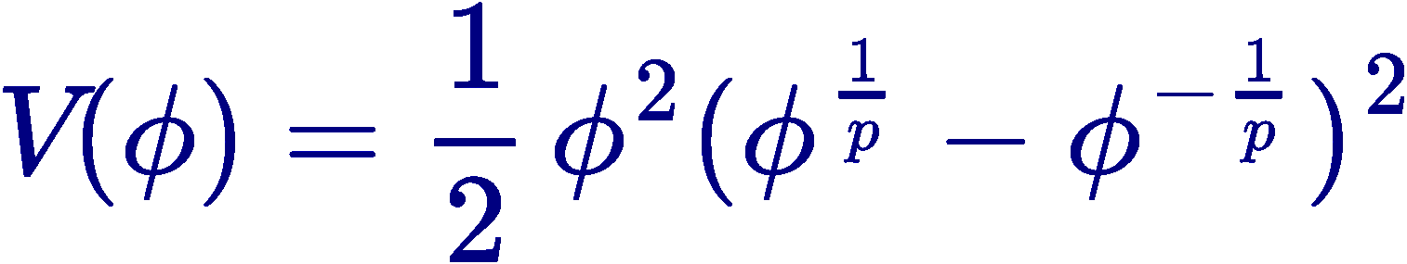
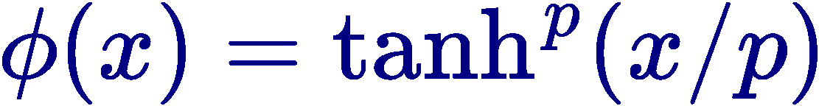
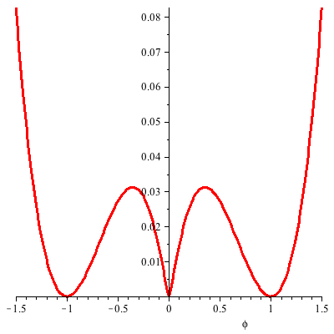
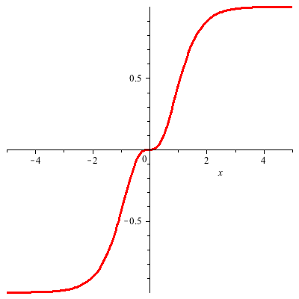
One Field
p-model
  pathological central minimum and 2-kink solution
DB, JMenezes and RMenezes, PRL (2003)

Slide 6
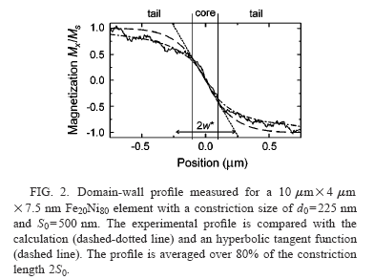
Example 1

Slide 7
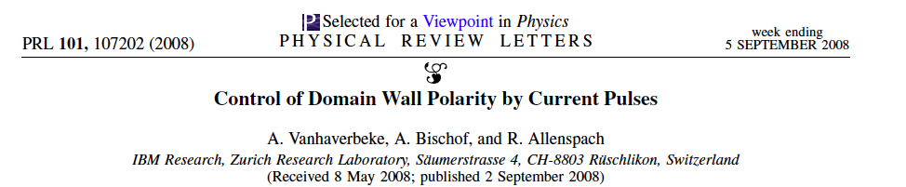
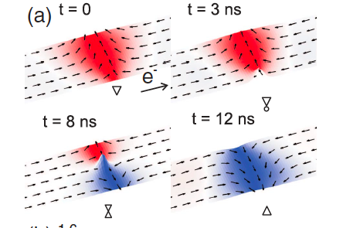
Example 2

Slide 8
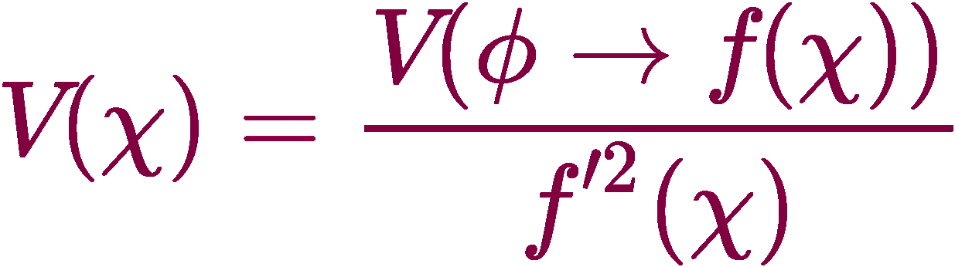
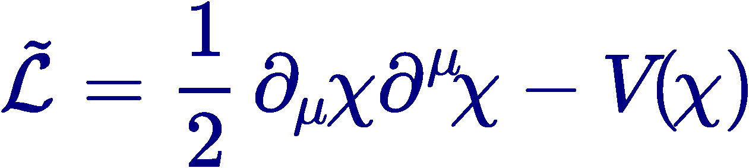
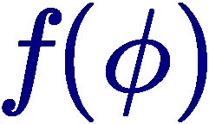
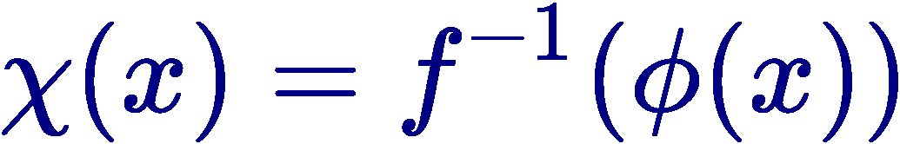


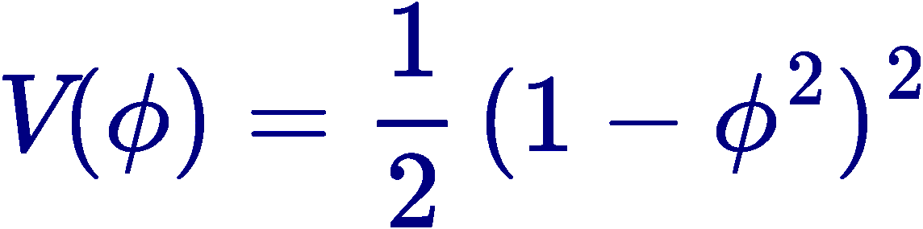
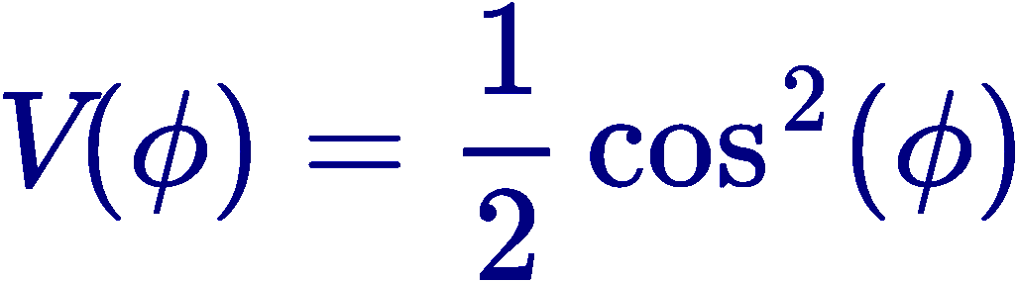
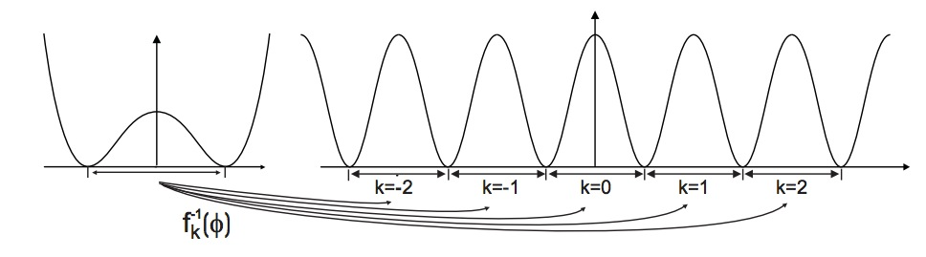
Deformation Procedure
DB, Losano, Malbouisson, PRD(2002)Rapid
Two models:
      Deformation Function
      Mapping of solutions
  Example:
DB, Losano, Malbouisson, RMenezes, PhysD (2008)
Ferreira, Zakrzewski, JHEP (2011); quasi-integrability

Slide 9
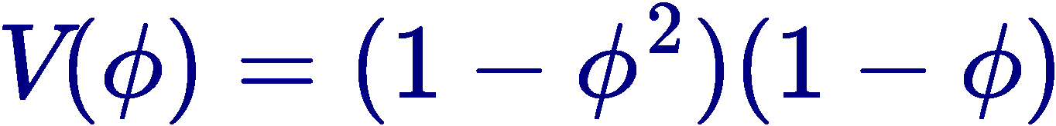
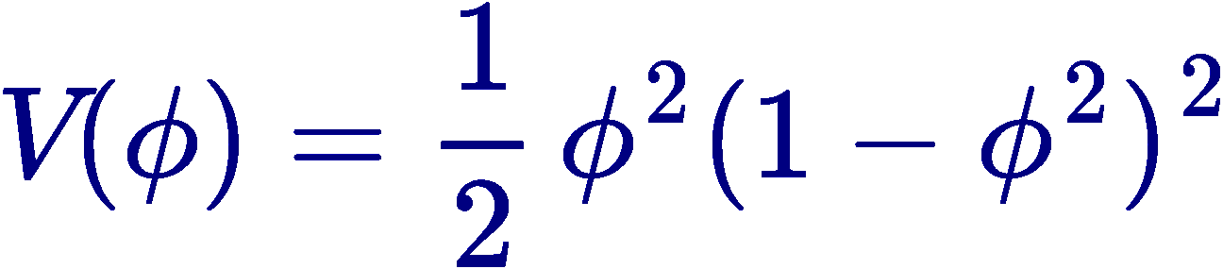
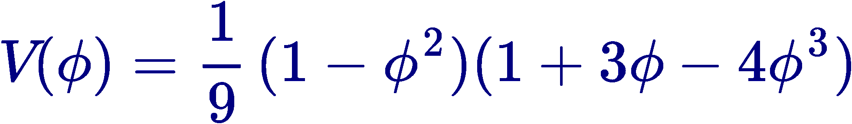
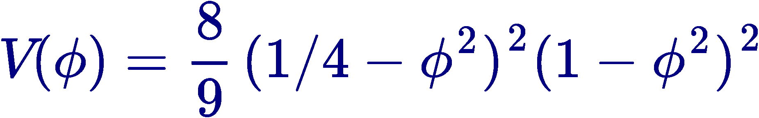
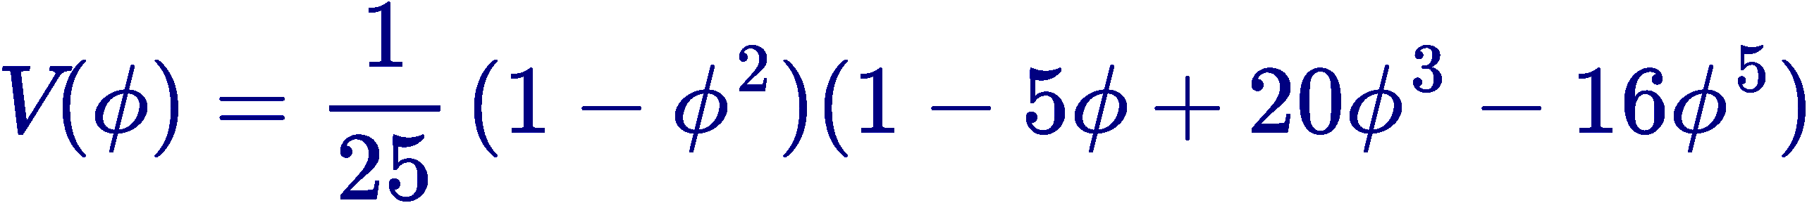
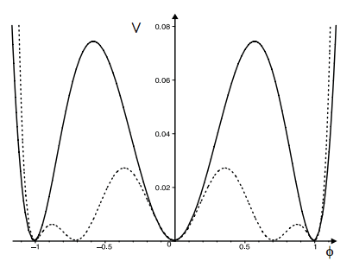
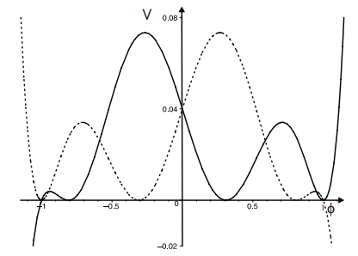
Deformation Procedure
  Example:
a integer
m=0
a semi-integer
Almeida, DB, Losano, Malbouisson, PRD(2004)
DB, Losano, PRD (2006) [Ferreira]
DB, Gonzalez Leon, Losano, Mateos Guilarte, PRD (2006)

Slide 10
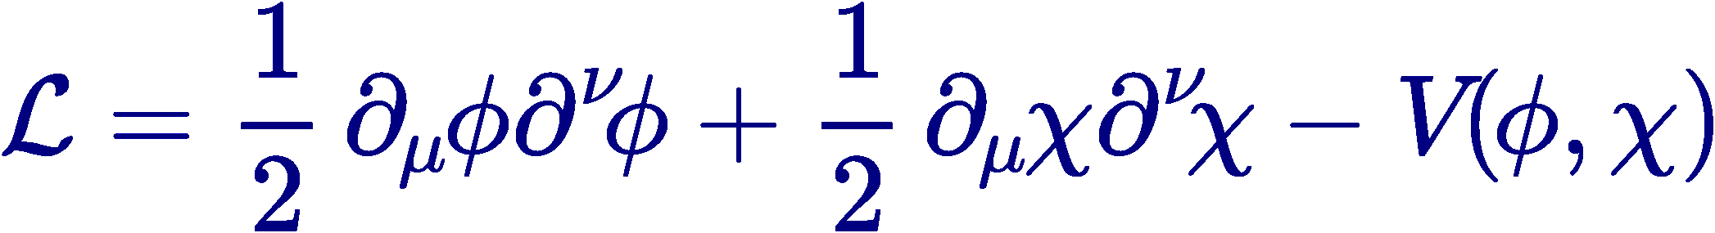
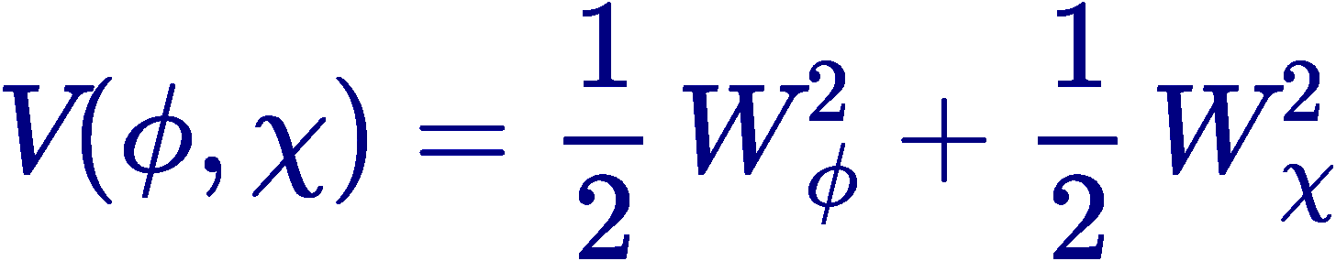
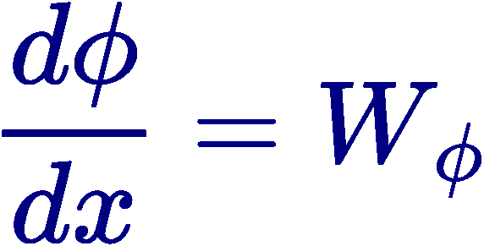

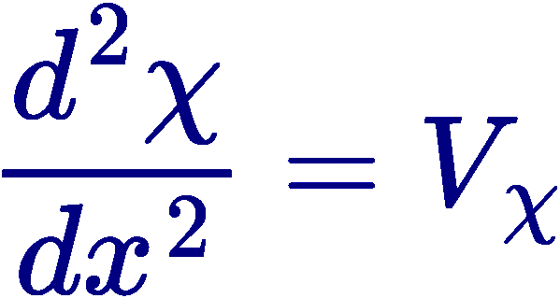
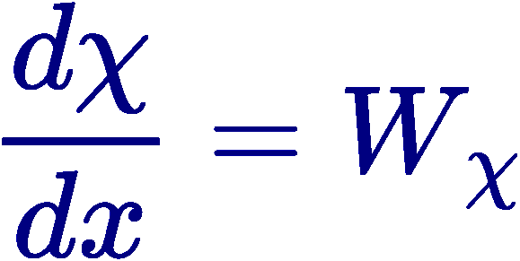


Two Fields
Generalities…
Potential minima
BPS sectors
&
DB, Santos, Ribeiro, PLA (1995)
…
Izquierdo, Gonzalez-Leon, Mateos-Guilarte, PRD (2002)…
Three Fields
DB, Losano, Wotzasek PRD (2002)

Slide 11
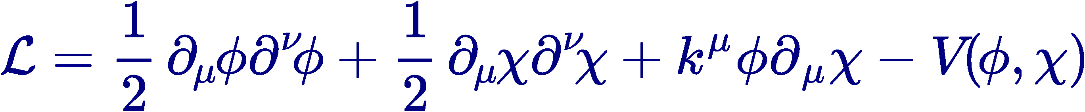
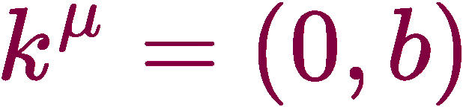
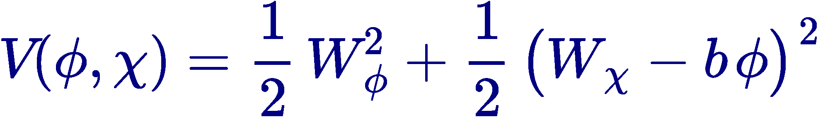
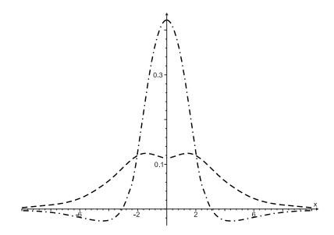
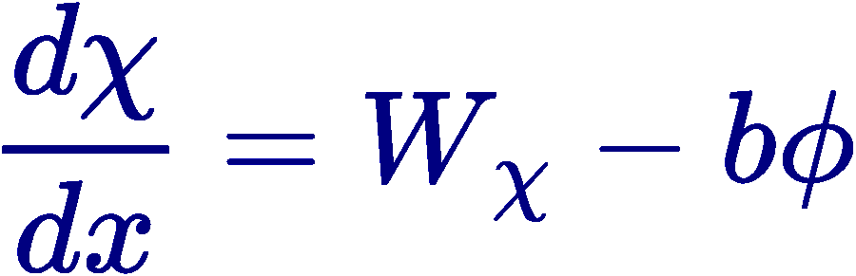
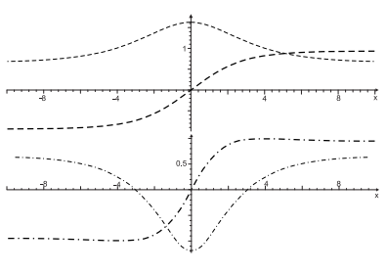
Two Fields
Lorentz breaking
BPS sectors
Non-monotonic solutions
Barreto, DB, RMenezes, PRD2006
DB, Ferreira Jr, Gomes, RMenezes, PhysD2010

Slide 12
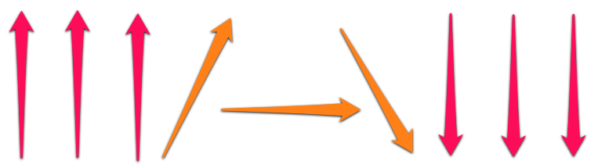
Applications
D=1
Magnetic Systems
Pattern Formation
Braneworld models
Cosmology
Chemistry (Polymers):
Polyethylene:
DB, Ventura, CPL(1999); Ventura, Simas, DB, CPL(2000)
BEC:
Avelar, DB, Cardoso, PRE(R)(2009)
Avelar, DB, Cardoso, PRE (2011+12)
...
Biology:
Langmuir films:
DB, Leite, Lima, Moraes, CPL(2001)
Diversity:
Avelino, DB, Losano, Menezes, PRE (2012)
Avelino, DB, Losano, Menezes, Oliveira, PRE(2012)
O. Oliveira, Jr: 2 papers: (1992+1993)
Math:
DB, Das, Losano, Santos, AML(2010)

Slide 13
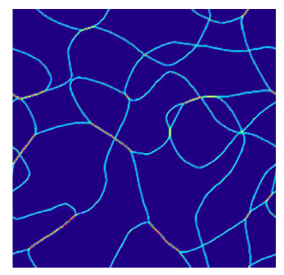
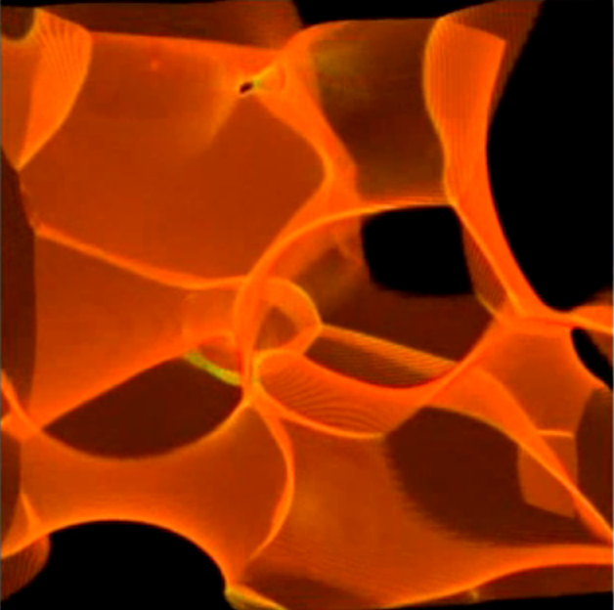
Applications
D=2
D=3
Ribbons
Domain Walls
Avelino, Oliveira, Martins, JMenezes, RMenezes
PRD (2006), PLB(2007), PRD(2008)

Slide 14
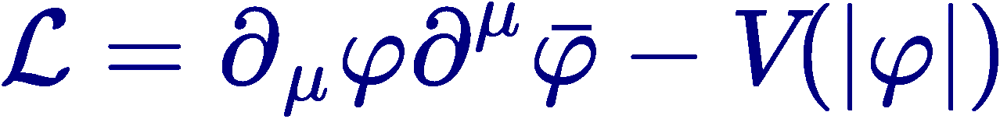
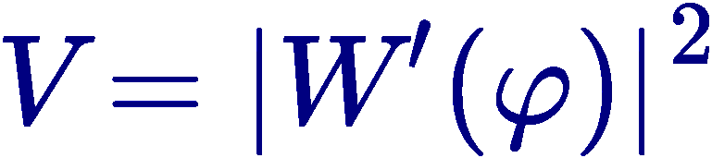




Two Fields
Complex Field
  Example
holomorphic function
DB,JMenezes, Santos,PLB2001; NPB2002:
Theorem: solutions are all PBS states
minima
Z_{N}
symmetry
2
3
,
4
5
,
,
,
...
Gibbons, Townsend, PRL99
Saffin, PRL99; DB, Brito, PRL2000

Slide 15







Generalized Dynamics
General Model
  Equation of Motion
  First Order Equation
  Example
Standard Case
Compactons
DB, Losano, RMenezes, JOliveira, EPJC(2007)
DB, Losano, RMenezes, PLB (2008)
Several works on compact vortices
E. da Hora

Slide 16











Twinlike Models
Two Distinct models
  with identical topological solution
  and identical energy density
and
ttt
Hhh
ALTW Model
Andrews, Lewandowski, Trodden, Wesley, PRD (2010)
topological solutions
Twinlike models, first paper
DB, Dantas, Gomes, Losano, Menezes, PRD (2011)
and

Slide 17






Twinlike Models
General Model/Strong Condiction
  with identical topological solution
  and identical energy density , if
  Strong Twin Condition
    Example:
identical
LINEAR FLUCTUATION SPECTRUM
DB, RMenezes, PRD(2011)
Adan, Queiruga, PRD (2012)
DB, Lobao Jr, Menezes, PRD, to appear

Slide 18










Braneworld
Randall, Sundrum, PRL (1999) (thin)
Goldberger, Wise, PRL (1999) (thick)
Thick Brane
  Warp Factor and scalar field .
AdS, M, dS
First Order Equations
Field and Einstein Equations
DeWolfe, Friedman, Gubser, Karch, PRD (2000)

Slide 19




Braneworld
Two Field scenario – Bloch Wall
DB, AGomes, JHEP (2004)
A Campos, PRL (2002), finite temperature
Internal structure
p-brane
DB, Gomes, Furtado JCAP(2004)
Brane with
Generalized Dynamics
DB, A. R. Gomes, L. Losano, R. Menezes PLB(2009)
DB, Lobao Jr, Menezes, PRD(2012)
Bent Brane
Afonso, DB, Losano, PLB (2006)
DB, Brito, Losano, JHEP (2006)

Slide 20

… and Cosmology
Analytical continuation
y → i t
t → - i y
Several works…
1999: Universe in accelerated expansion
The 2011 Nobel Prize: Riess, Schmidt, and Perlmutter
Or better: start from FRW cosmology
DB, C Gomes, Losano, RMenezes PLB(2006)
First-order formalism
DB, Losano, Rodrigues, Rosenfeld, EPJC(2008)
with dust
DB, Hoff da Silva, Rocha
Black string Cosmology

Slide 21



Thanks to
Collaborators

