Slide 2


The Role of Surface Interactions on Xylella fastidiosa Initial Adhesion Stages
Mônica A.Cotta
Universidade Estadual de Campinas (UNICAMP)
Instituto de Física Gleb Wataghin, Campinas-SP, Brazil

Slide 3
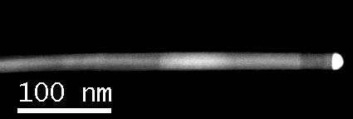

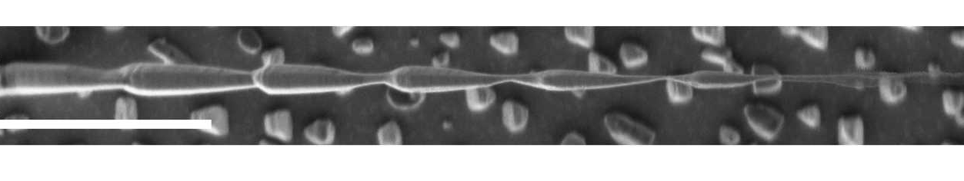
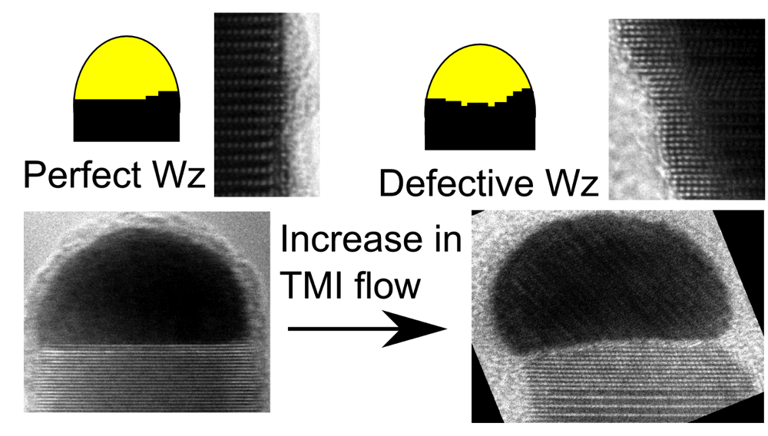
Materials Science
Semiconductor nanowires
InP
InAs
InP
InP
Au
L.H.G.Tizei
D.S.Oliveira
L.H.G.Tizei et al., Phys.Rev.Lett. (2011)
T.Chiaramonte et al., Nano Lett (2011)
Eshelby twist

Slide 4
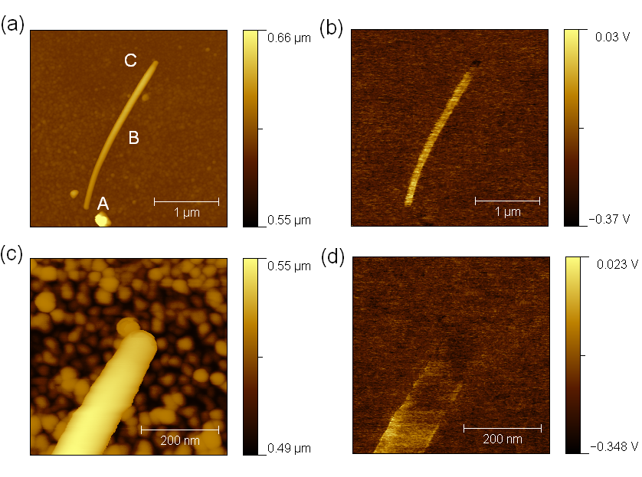
Scanning Probe Microscopy
Electrical modes
Conductive-AFM
Kelvin Probe Force Microscopy
A.C.Narvaez et al.,
Nanotechnol. (2009)
P.Sahoo et al.,
J.Phys.Chem.C (2011)

Slide 5
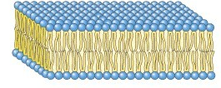
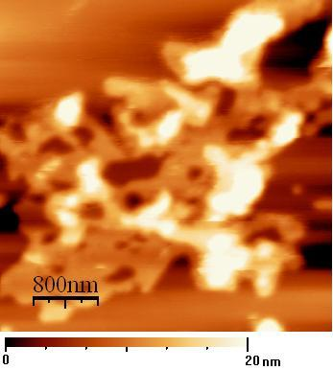
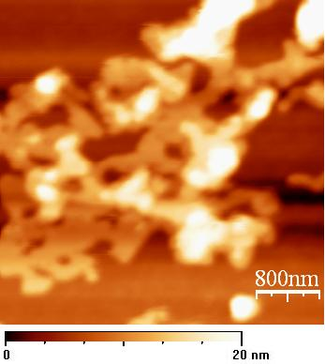
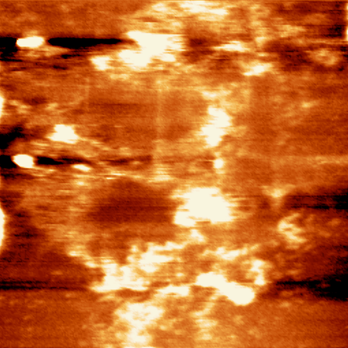
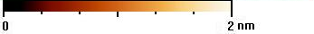
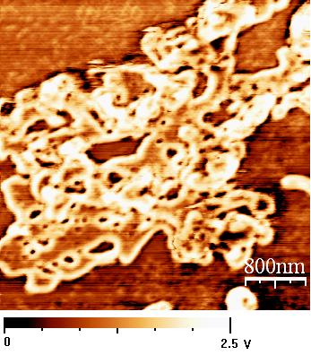
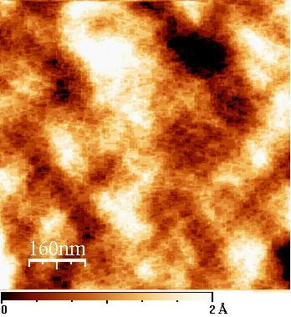
Real time imaging in solution
Dibucaine
+
A
B
DBC added
into AFM
liquid cell;
“real time”
imaging
D
C
G.S.Lorite, T.M.Nobre, E.de Paula, M.E.D.Zaniquelli, M.A.Cotta,
Biophysical Chemistry, 139, pp. 75-83 (2009).

Slide 6


Biological processes
IFGW:
Prof. Mônica A.Cotta
Dr. Richard Janissen
Alberto L.D.Moreau
Gabriela S.Lorite
Duber M.Murillo
Eng. João H. Clerici
IB:
Prof.Dagmar Machado
Prof. Anete Pereira de Souza
IAC/CC:
Dr.Alessandra A.de Souza
Carol Rodrigues
Dr.Juarez P.Tomaz
Univ. Ulm, Germany:
Prof. Boris Mizaikoff
Dr. Christine Kranz

Slide 7
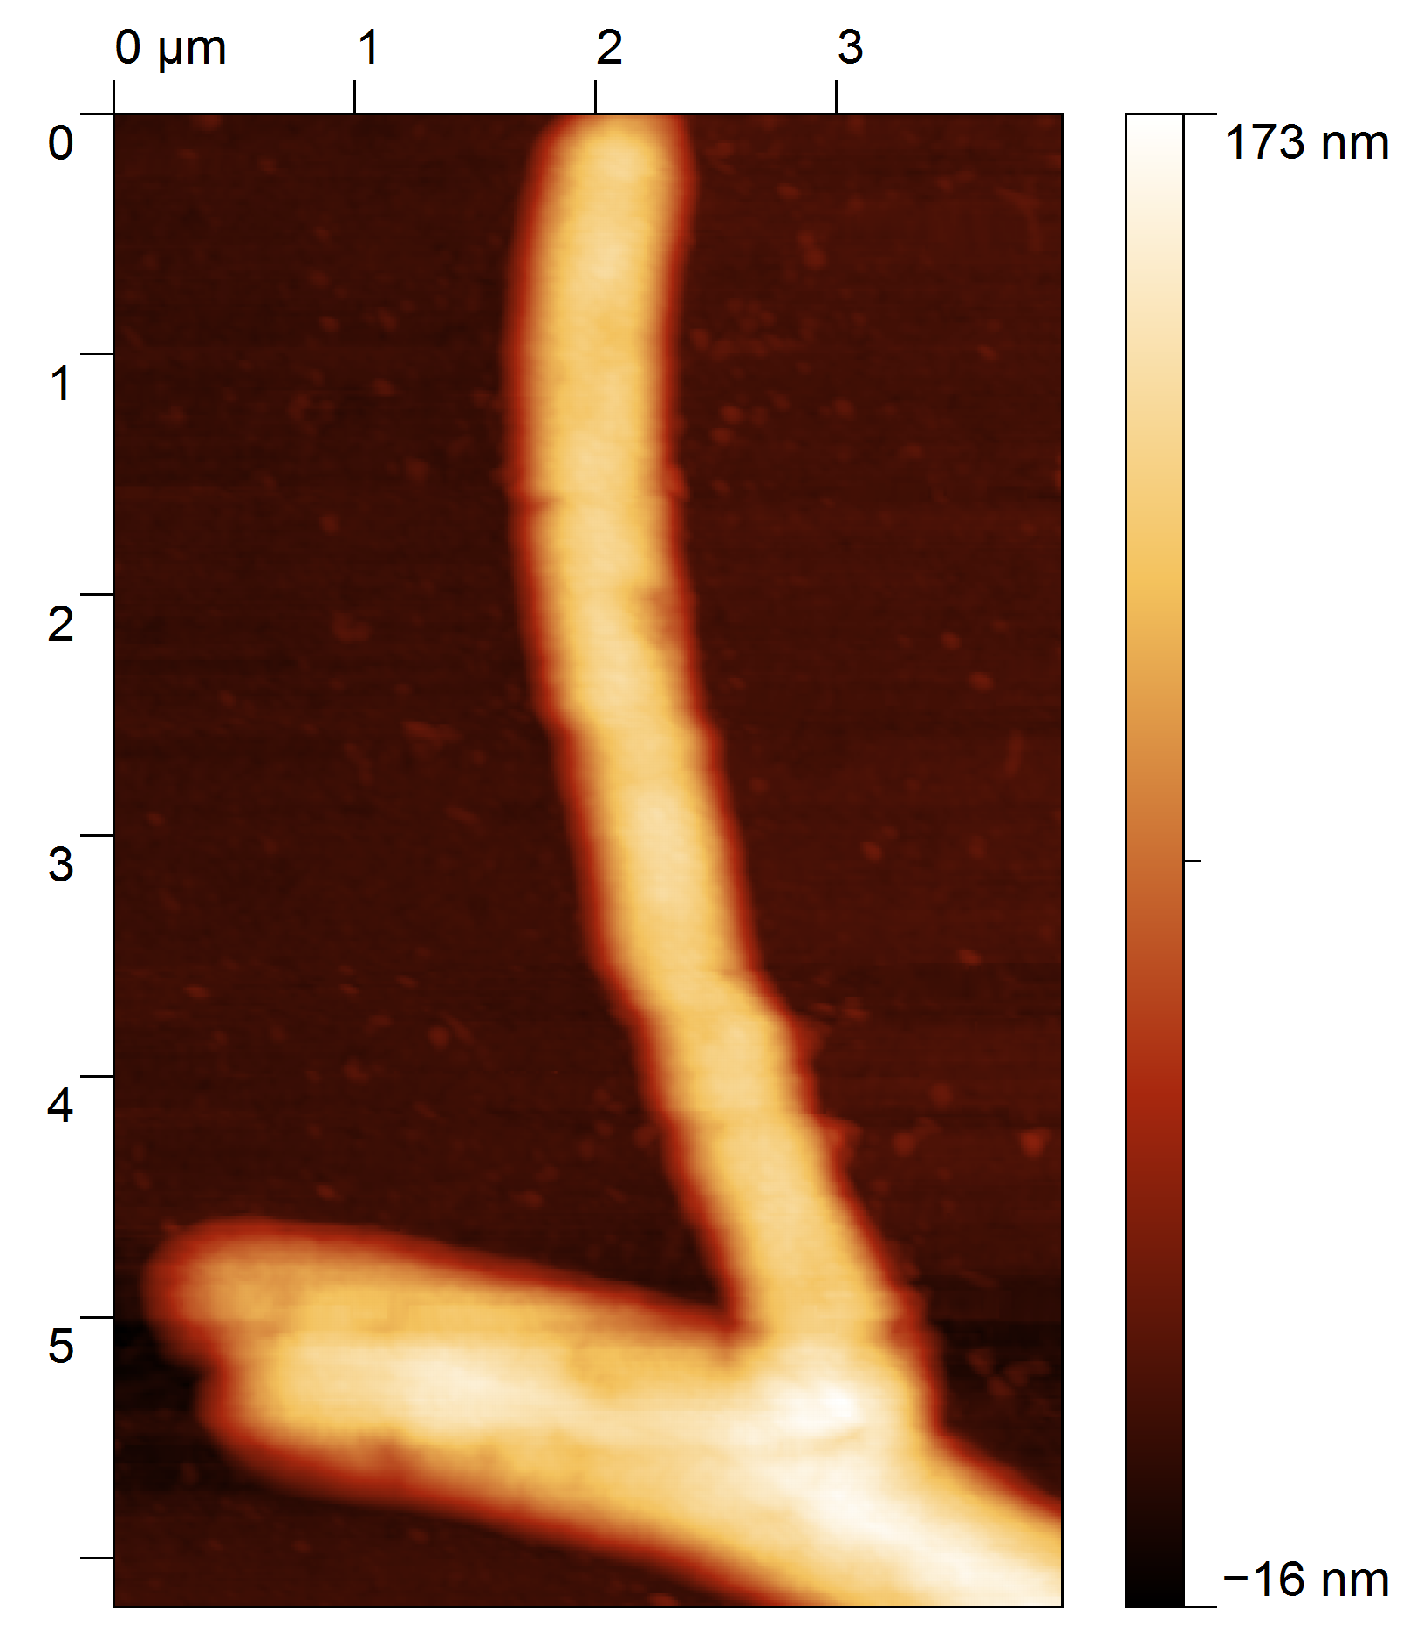
Xylella fastidiosa
Gram negative bacteria
~300–500 nm in diameter and 0.9–5μm in length
Slow growth rate (~6-48hs) and harmless
Several economically important diseases in citrus plants
citrus variegated chlorosis
~ USD 300million/year losses to citrus industry
First phytopathogenic bacterium with a complete genome sequence
Nature 406, 151 (2000)
Pathogenicity results from biofilm formation inside the plant xylem vessels
Blockage and consequent water stress plant starves!
176nm
1μm
-16nm
http://www.cnr.berkeley.edu/xylella/

Slide 8
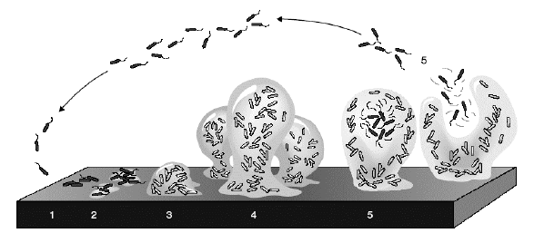
Bacterial Biofilms
Biofilm Formation in 5 steps:
Pioneer bacterial cells reversible attachment to surface
Irreversible attachement (influence of EPS - extracellular polymeric substance)
(3) Cell-Cell adhesion and proliferation
(4) Mature biofilm
(5) Detachment
To learn more:
“Slime City: Where Germs Talk to Each Other and Execute Precise Attacks"
Discover magazine, July-August 2009
K. Sauer, Genome Biology 4, 219 (2003)
SPM analysis??
Large sizes
Biological sample reproducibility issues

Slide 9
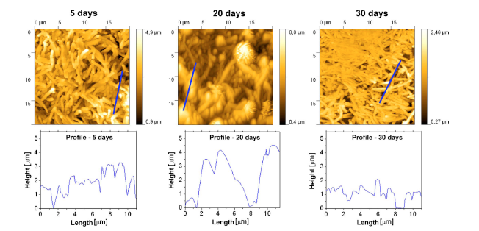
Dry biofilms
Very different profiles fractal (statistical) analysis

Slide 10




Scaling analysis
Box counting techniques:
Dynamical scaling theory:
with
Fractal dimension:
To learn more:
“Fractal concepts on surface growth”
A.L.Barabási and H.E.Stanley
Cambridge Univ.Press, 1995
http://rsb.info.nih.gov/ij/plugins/fraclac/FLHelp/BoxCounting.htm

Slide 11
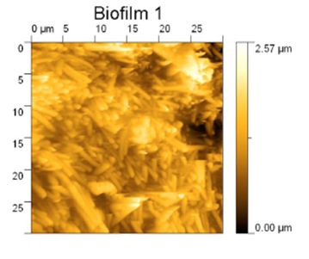
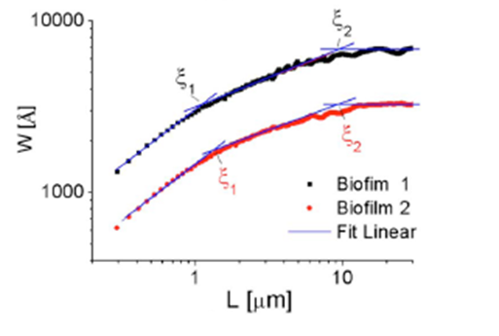
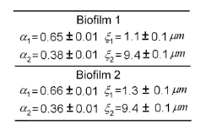
Different biofilms on the same sample
saturation
Different biofilms BUT
similar scaling properties
Single bacteria
Biofilm structure

Slide 12
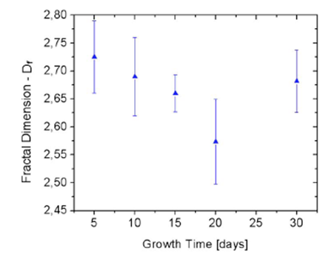
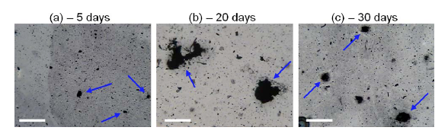
Growth mechanisms
Eden-like models:
D_{f} ~2.7
Diffusion limited
aggregation: D_{f} ~2.5
Rich nutrient
conditions
or degradation
Circular shapes:
No branching
Low nutrient
conditions
Diffusion Barrier
Branching:
Biofilm architecture
EPS (~10 days)
100 μm
100μm
100 μm
A.L.D.Moreau et al, J.Appl.Phys. (2009)

Slide 13
Initial adhesion stages
Reversible adhesion:
Electrostatic nature
K. Sauer, Genome Biology 4, 219 (2003)
Irreversible adhesion:
Chemical nature

Slide 14
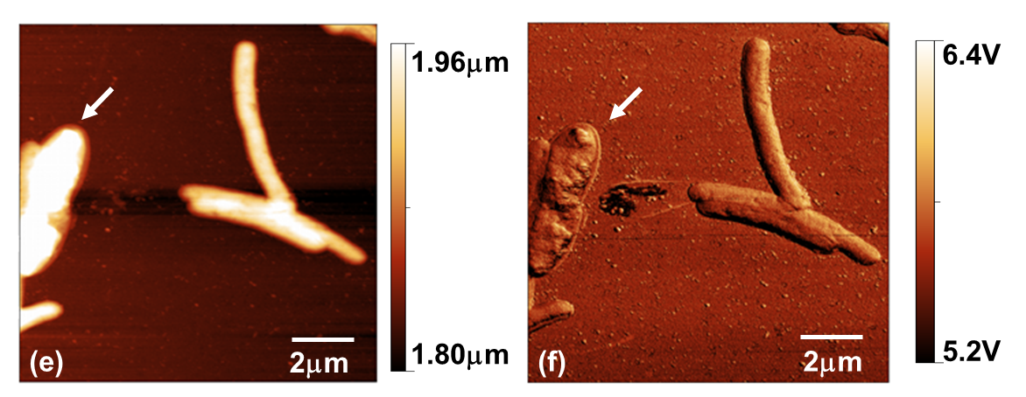
SPM & IR – Glass surfaces
Live Bacteria grown inside AFM
liquid cell at 28C
ATR- IR
Boris Mizaikoff and Christine Kranz
Dry samples (cells around BF, 7 days)
Conditioning film due to culture medium:
changes in hydrophobicity
G.S.Lorite et al., Journal of Colloid and Interface Science 359 (2011) 289–295

Slide 15
Different surfaces
Silicon
Ethylcellulose
Cellulose acetate
Si
EC
AC
Si:
Defined edges
Large BFs
Large number of BFs
Enhanced adhesion and higher development rates for X. fastidiosa biofilm growth on Si surface than EC and AC surfaces
G.S.Lorite, submitted (2012)

Slide 16
Kelvin Probe Force Microscopy (KPFM)
Topography
Surface potential
Acetate
Cellulose
(AC)
Ethyl
Cellulose
(EC)

Slide 17
Surface Potential – Si as reference
EC: more porous film, Si surface (microscopically) exposed

Slide 18
Si - Contact with PW

Slide 19
Cellulose - Contact with PW
G.S.Lorite et al, APL (under review, 2012)

Slide 20
Conditioning film – PW on substrate
Biofilm development:
optical/electron microscopy + gene expression (cellulases)
Si +
Si +
(reference)
Surface Potential
Biofilm development rate

Slide 21
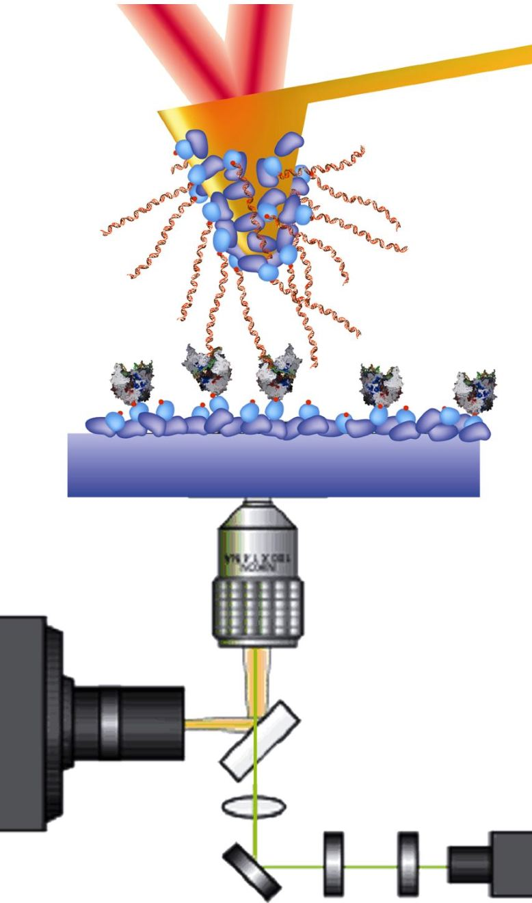
Force spectroscopy
Tip functionalization XadA1 adhesine
PBS buffer
Si cantilever
Protein
Surface
control
AC
AC
offset

Slide 22
Force spectroscopy
Si
EC
Force (nN)
#2
#1
AC
AC
Sequence of measurements

Slide 23
Force spectroscopy
AC
AC
AC
AC
Specific binding to AC surfaces less likely than for Si and EC
SP + force spectroscopy: different shapes of biofilms
G.S.Lorite et al., under review, 2012

Slide 24
Back to KPFM
Si +
Si +
(reference)
Au +PW
Surface Potential
Au (-140)mV
Biofilm development rate

Slide 25
Experimental Identification
Bacteria close to BF edges:
Capsular
EPS
7 days
14 days
21 days
7 days
Topography
EPS
around
the cells
14 days
Phase
EPS cap
layer
Surface Potential
21 days
Duber Murillo, unpublished (2012)

Slide 26
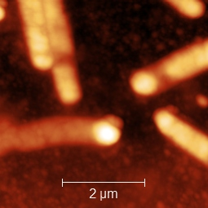
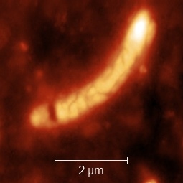
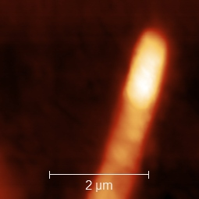
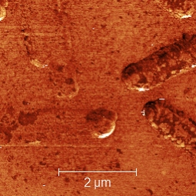
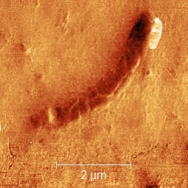
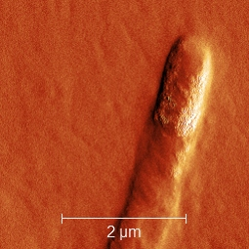
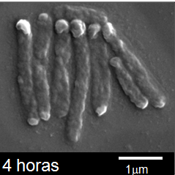
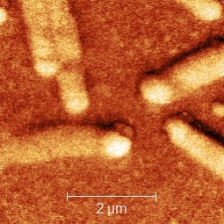
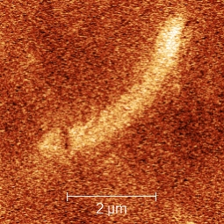
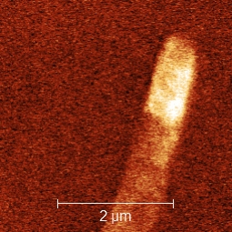
New features?
7 days
14 days
21 days
Bacterial Poles??
Topography
Phase
Surface Potential

Slide 27
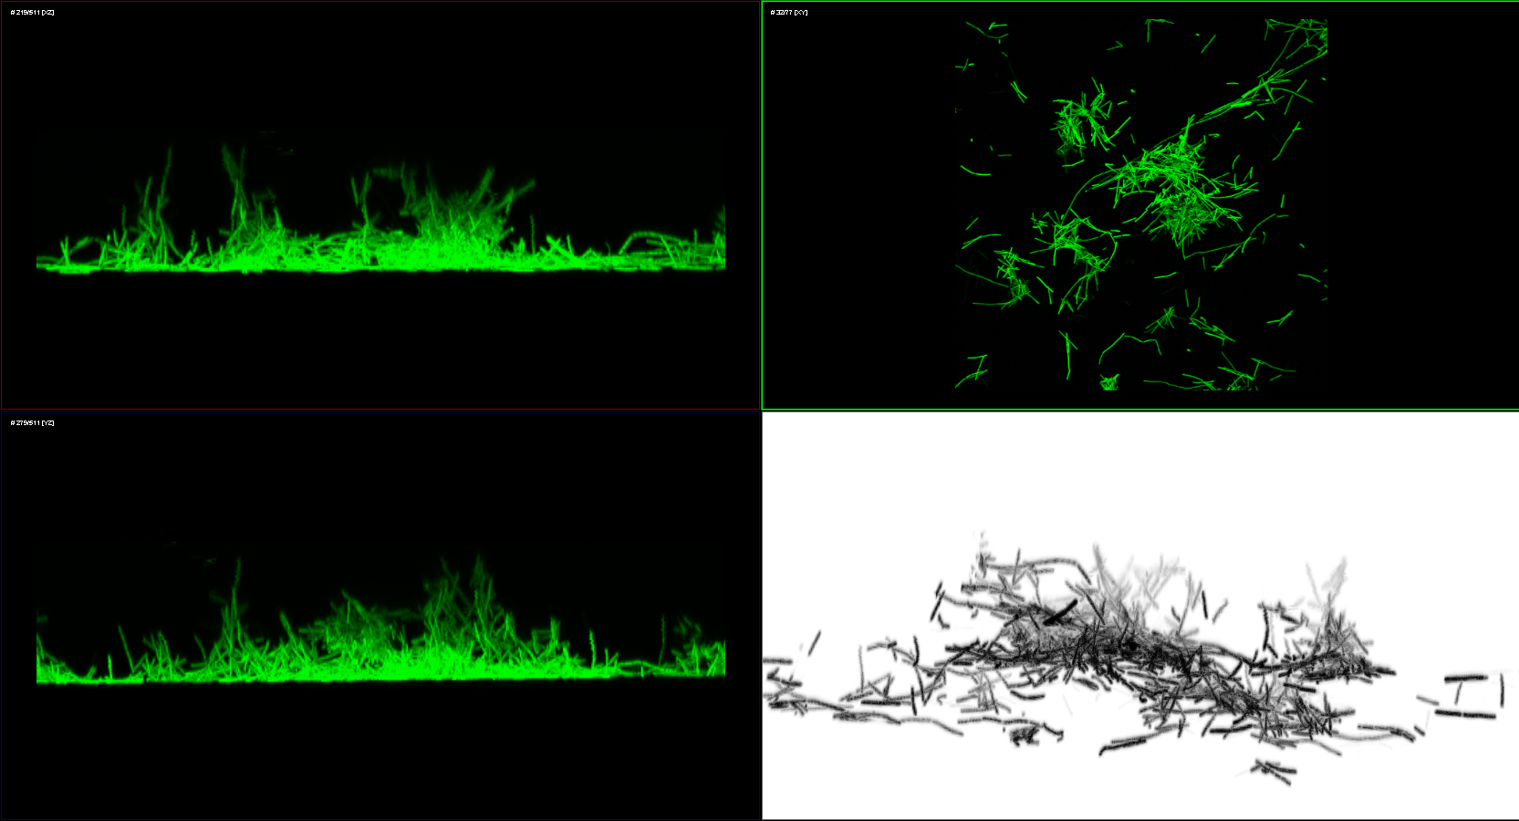
Role of cell edges on adhesion?
Xylella with GFP:
With C.Lenz, INCT on Biophotonics

Slide 28
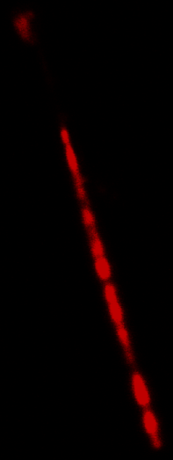
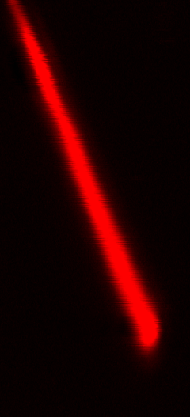
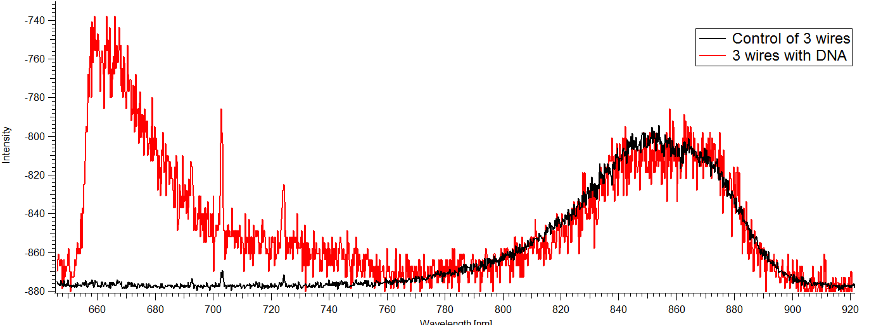
Back to semiconductors…
 | MCE [ng/ml] | NsR [ng/ml] | SeR [ng/ml] | SaR [ng/ml]
40bp DNA | 4 (s= 2) | < 30 (1pM) | 30 ~ 715 | > 715
Xylella fastidiosa | 18 (s= 9) | < 34 (1.9nM) | 34 ~ 250 | > 250
Citrus Tristeza Virus | 32 (s= 16) | < 60 (2.3nM) | 60 ~ 340 | > 340
A.L.D.Moreau, Biosensor and Bioelectronics (2012)
Autofluorescence
Fluorescence of DNA-Atto647N
Uniform & higher
fluorescence signal
5µm
3µm
Autofluorescence
Excitation: 633nm
Emission: 639-758nm
Excitation: 633nm
Emission: 640-700nm
R.Janissen (2012)

Slide 29
Conclusions
Quantitative measurements of important biological parameters:
Roughness
Hidrophobicity
Electrostatic character
Surface modification
for different materials on which Xyllela fastidiosa can grow
hydrophilic surfaces
Biology: Non-specific interaction between cell and surface
  Adaptation mechanism to compensate for variability in
  plant xylem??

Slide 30
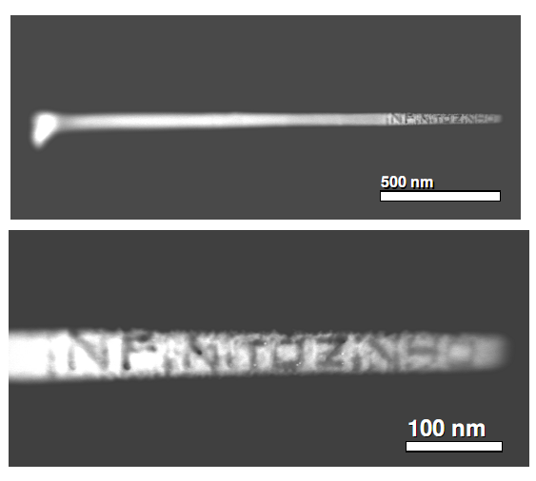
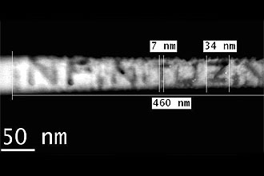

Knowledge but with imagination…
FEG/STEM alignment:
InP NW
Poem by
Arnaldo Antunes
“small infinite"
Nanopoem by
L.H.G.Tizei and
Daniel Ugarte

Slide 31


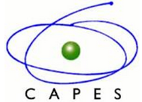

Financial Support
Notes:
31
31

Slide 32
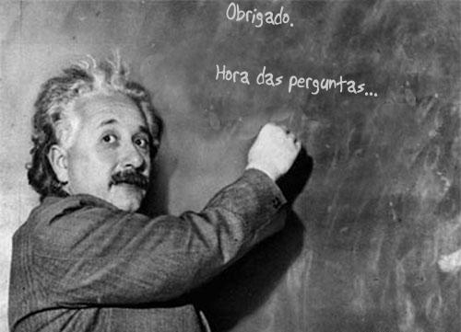
Thank you!!

