Slide 1
Instituto de Física da Universidade de São Paulo, São Carlos
“Projeto Café com Física”
Relação entre elasticidade de DNA e a ligação cooperativa de proteínas e fármacos
Oscar Nassif Mesquita
Departamento de Física, Universidade Federal de Minas Gerais, Belo Horizonte
Trabalho em colaboração com:
Lívia Siman Gomes (Doutoranda, Física - UFMG)
Ismael S. Silva Carrasco (Mestrando, Física - UFV)
Prof. Jafferson K. L. da Silva (Física - UFMG)
Prof. Ricardo S. Schor (Física – UFMG)
Profa. Mônica C. de Oliveira (Farmácia – UFMG)
Prof. Márcio Santos Rocha (Física – UFV)
Agências financiadoras:
Fapemig, CNPq, Pronex-Facepe, INCFx-Instituto Nacional de Fluidos Complexos e Aplicações

Slide 2
Outline
Stretching single DNA molecules with optical tweezers: measurement of the persistence length and contour length.
Study of the interaction between DNA and molecules of pharmaceutical interest.
Interaction between DNA and beta-cyclodextrin: non-monotonic flexibility.
HU-DNA interaction: previous example of non-monotonic flexibility.
Hill cooperativity in biochemical reactions.
Our two-sites quenched disorder model to explain non-monotonic flexibilities.
Results and discussion.
Conclusions.

Slide 3
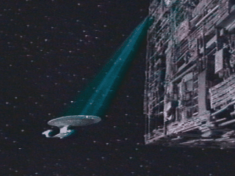
An optical tweezers is just a light beam trapping some material
(A. Ashkin example)

Slide 4
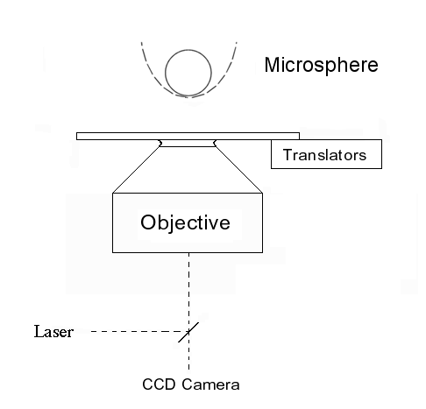
Single Molecule Experiments
Schematic set-up of optical tweezers
Optical tweezers is an invention of A. Ashkin in 1970, Phys. Rev. Lett. 24, 156 (1970)
Complete theory of optical tweezers for dielectric spheres by Maia Neto and Nussenzveig (Europhys. Lett, 50, 70C2 (2000)), and Mazolli, Maia Neto and Nussenzveig (Proc. R. Soc. Lond. A 459, 3021 (2003)), named Mie-Debye (MD) theory.
Viana, Rocha, Mesquita, Mazolli, Maia Neto, and Nussenzveig, APL (2006), and PRE (2007).

Slide 5
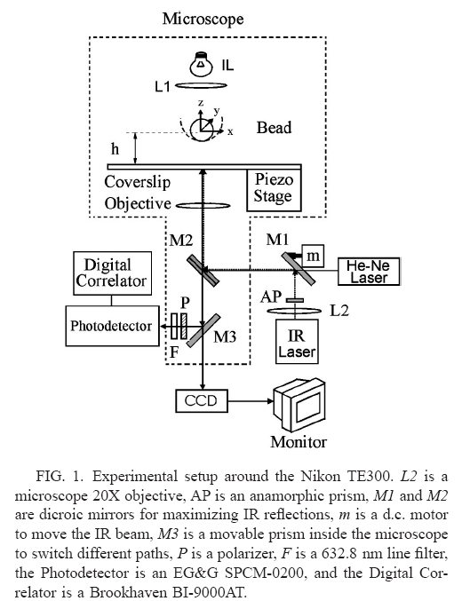
Set – up at UFMG

Slide 6
Brownian motion of a microsphere in a harmonic potential
Langevin equation:
Position correlation function satisfies the Langevin equation:
Neglecting inertia and using the equipartition theorem

Slide 7
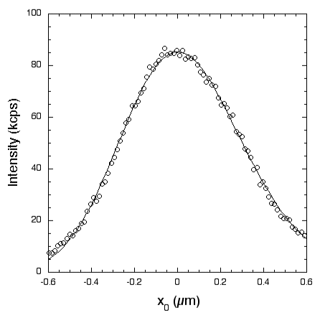
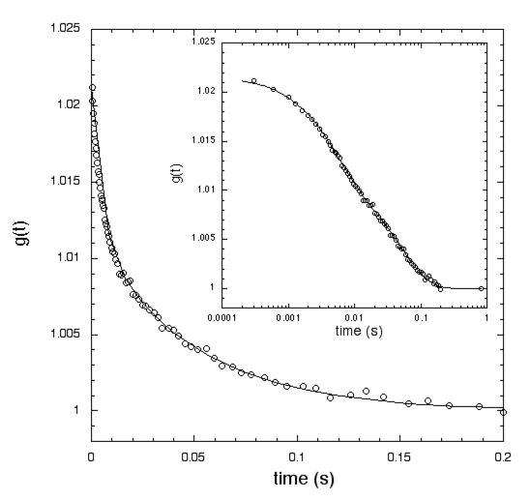
Time autocorrelation function of back-scattered intensity fluctuations of a trapped bead
Intensity back-scattering profile
From the time autocorrelation function we obtain the tweezers´ stiffness for motion perpendicular and parallel to the incident direction.

Slide 8
Tweezers calibration with video-imaging
$\frac{E}{k_{B}T}$=-ln (probability)

Slide 9
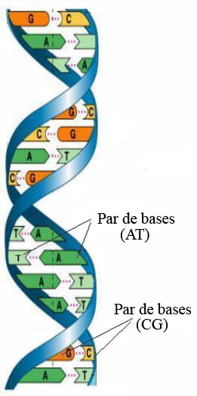
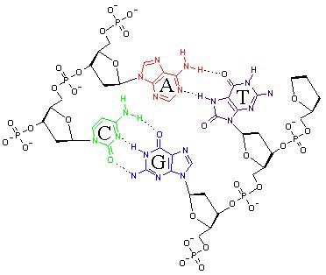
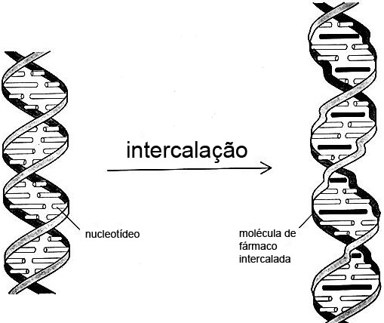
Entropic elasticity of a single DNA molecule
DNA and RNA stretching experiments
First experiment by Carlos Bustamante and co-workers Science (1992)
Nucleotides
Adenine, Guanine, Cytosine, Tymine
Notes:
9

Slide 10
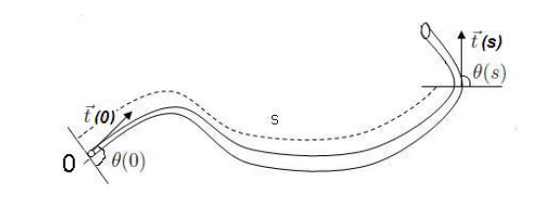
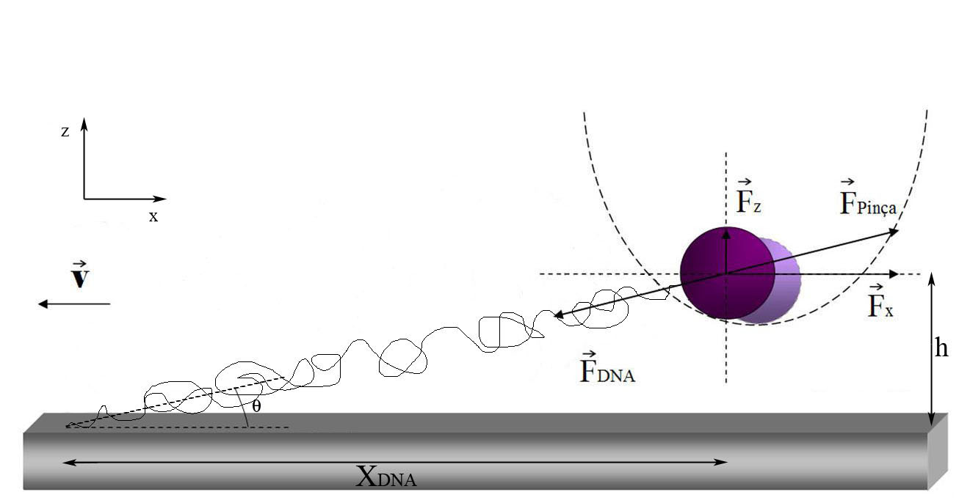
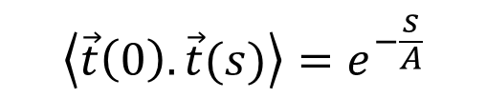
Stretching DNA : entropic elasticity
$$\left\langle \vec{t}\left(0\right).\vec{t}(s)\right\rangle =e^{−\frac{s}{A}}$$
A is the polymer persistence length
A = bending rigidity/thermal energy
Notes:
10

Slide 11
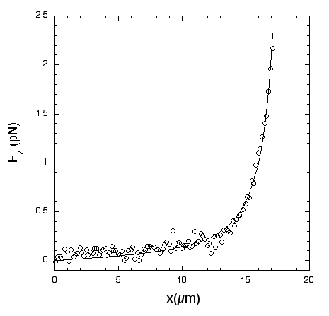
Marko and Siggia expression for the entropic force, where A is the persistence length, z is the end-to-end distance and L is the contour length of the polymer.
Viana, Freire & Mesquita, PRE 65, 041921 (2002)

Slide 12
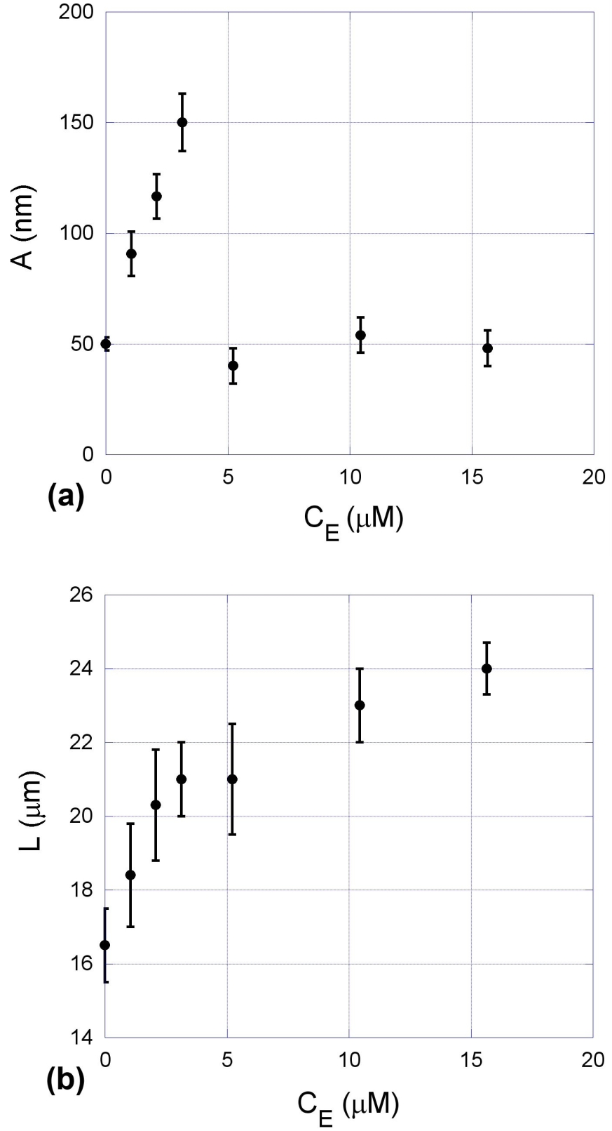
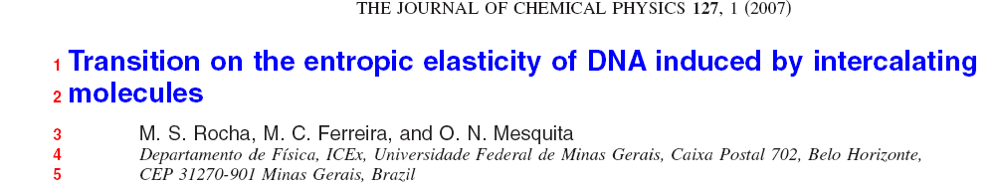
DNA/Ethidium Bromide
Fit to the neighbor exclusion model

Slide 13
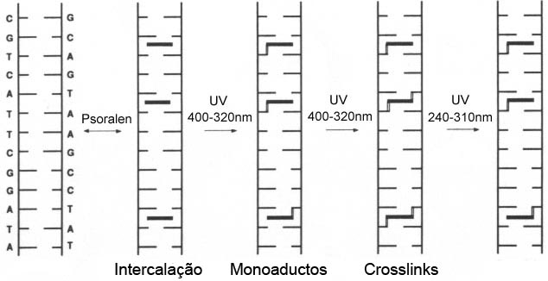
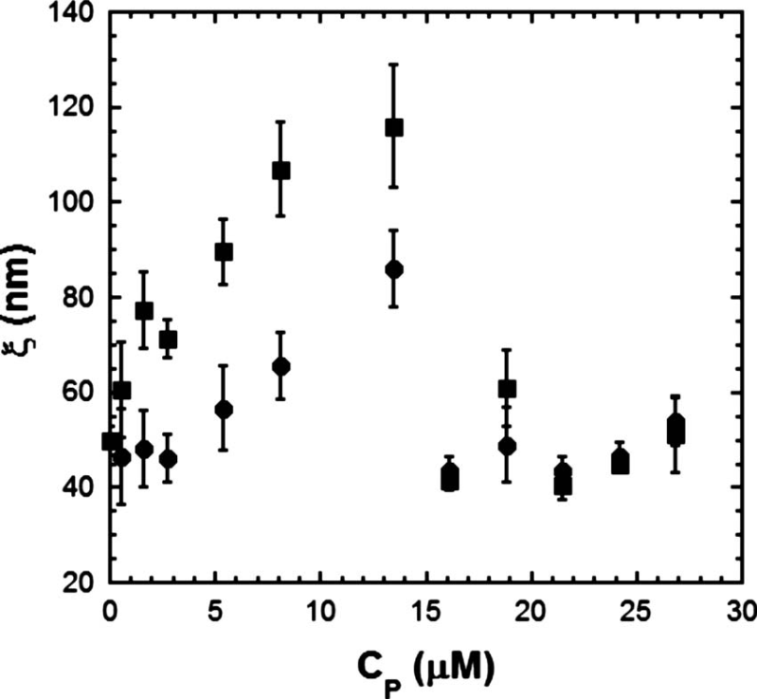
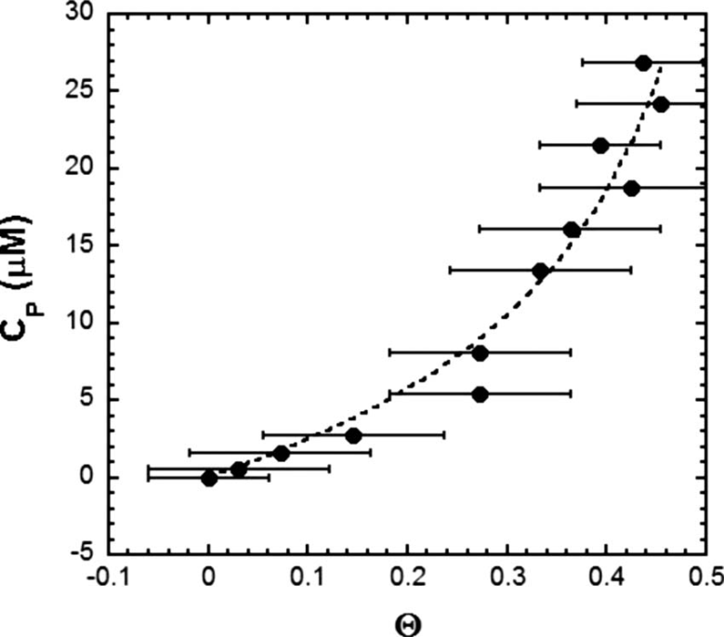
DNA-psoralen interaction
Persistence length with and without
UV light
Relative increase of contour length

Slide 14
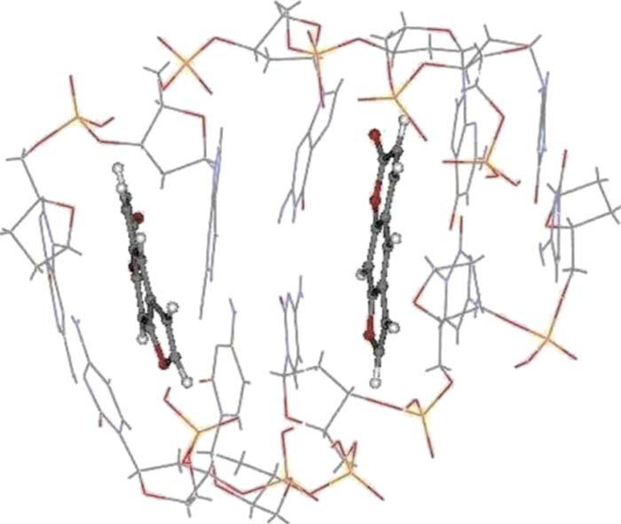
ab initio DFT calculations
Psoralen-DNA fragment with five base CG pairs and two
intercalated psoralens obtained from our ab initio DFT calculations.
DNA-psoralen: Single-molecule experiments and first principles calculations, APL (2009)
M. S. Rocha, A. D. Lúcio, S. S. Alexandre, R. W. Nunes, and O. N. Mesquita

Slide 15
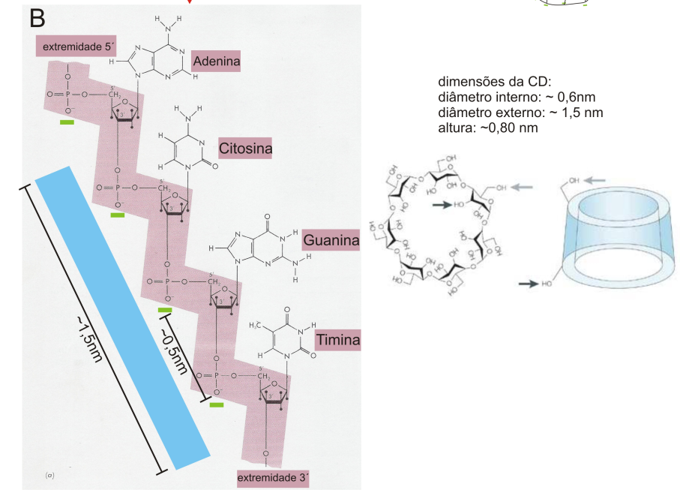
Cyclodextrins are used for condensing DNA
into small lipid vesicles for gene therapy

Slide 16
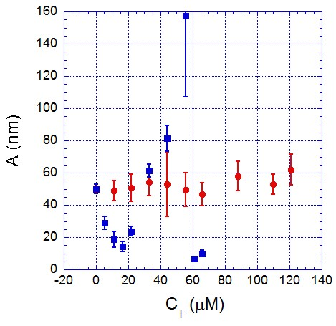
CD-DNA persistence length measured with optical tweezers
Blue squares – cationic CD Red circles – neutral CD

Slide 17
HU-DNA persistence length measured with magnetic tweezers
(continuous curve is a guide to the eye)
total HU concentration (nM)
J. van Noort et al., PNAS 101 (18), 6969 (2004)

Slide 18
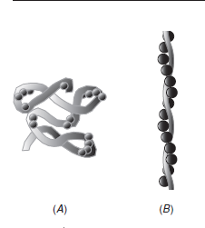
HU-DNA model for binding and DNA structural changes
Sagi et al., J. Mol. Biol., 341, 419 (2004)
smaller persistence length
larger persistence length
HU dimmers (spheres) bind cooperatively (bound-clusters with 4 or 5 HU molecules as measured by FRET) and compacts DNA at low protein concentration, each HU dimmer introducing a small local bend.
At high HU concentrations, compactation by HU is reversed, and the protein appears to form a complex with helical structure with DNA.

Slide 19
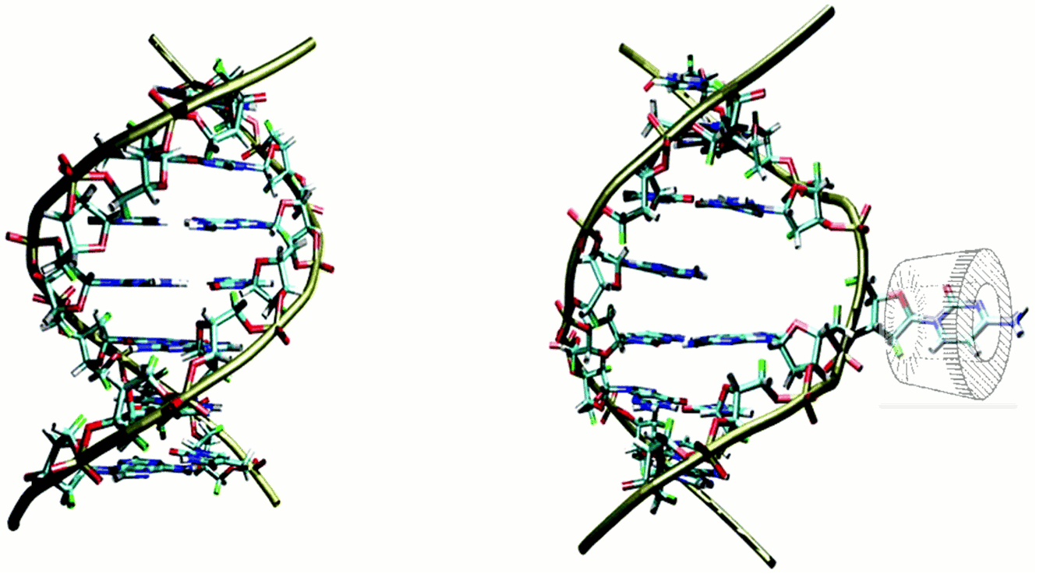
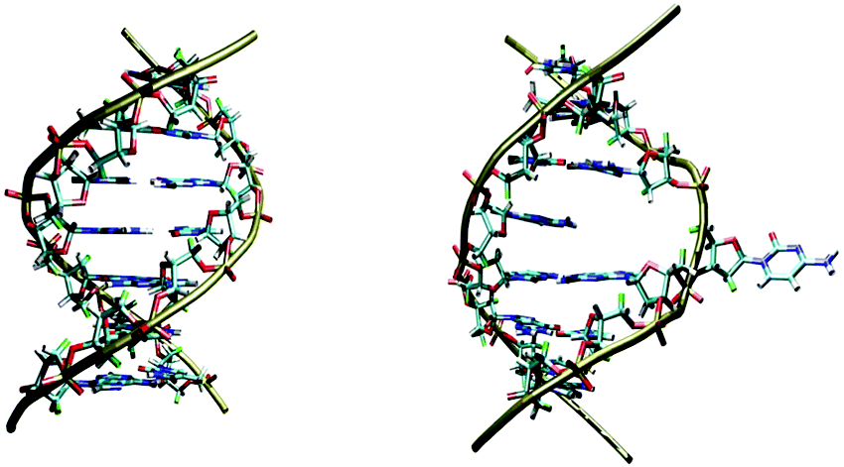
A mechanism of interaction of CD and DNA with a flipping-out DNA base
M. A. Spies and R. L. Schowen, J. Am. Chem. Soc. 124, 14049 (2002)

Slide 20
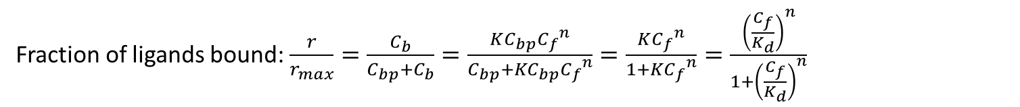


Hill cooperativity
n ligands bind simultaneously to the substrate (bound-cluster)
L for ligand and S for substrate $nL+S\underset{→}{K}L_{n}S$
Mass-action law:$K=\frac{\left[L_{n}S\right]}{\left[S\right]{\left[L\right]}^{n}}=\frac{C_{b}}{C_{bp}{{ C}_{f}}^{n}} (chemical constant)$
Fraction of ligands bound: $\frac{r}{r_{max}}=\frac{C_{b}}{C_{bp}+C_{b}}=\frac{KC_{bp}{C_{f}}^{n}}{C_{bp}+KC_{bp}{C_{f}}^{n}}=\frac{K{C_{f}}^{n}}{1+K{C_{f}}^{n}}=\frac{{\left(\frac{C_{f}}{K_{d}}\right)}^{n}}{1+{\left(\frac{C_{f}}{K_{d}}\right)}^{n}}$
$K_{d}$ is the dissociation constant;
for $C_{f}=K_{d , }\frac{r}{r_{max}}=\frac{1}{2}$
Hill exponent
n < 1 negative cooperativity
n = 1 non-cooperativity
n > 1 positive cooperativity
$K_{d}$ = 40

Slide 21
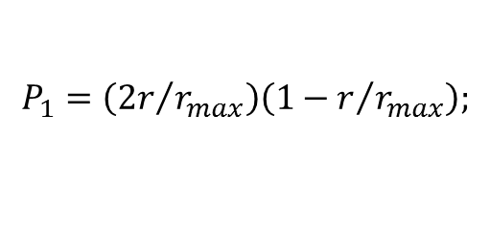
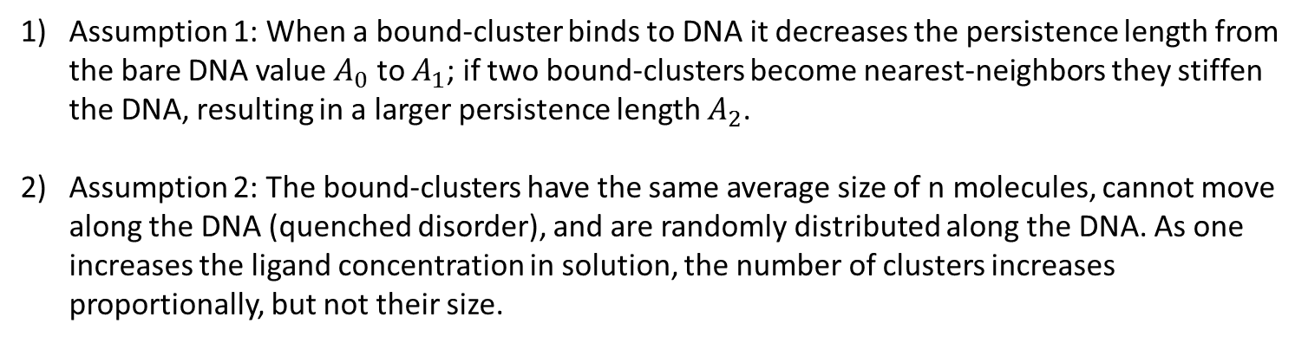

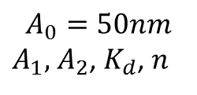
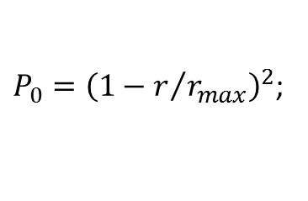
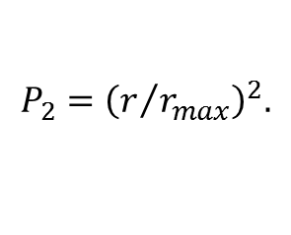
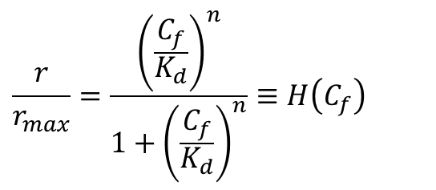

Two-sites quenched disorder model
Assumption 1: When a bound-cluster binds to DNA it decreases the persistence length from the bare DNA value $A_{0}$ to $A_{1}$; if two bound-clusters become nearest-neighbors they stiffen the DNA, resulting in a larger persistence length $A_{2}$.
Assumption 2: The bound-clusters have the same average size of n molecules, cannot move along the DNA (quenched disorder), and are randomly distributed along the DNA. As one increases the ligand concentration in solution, the number of clusters increases proportionally, but not their size.
a) Two sites empty, $A_{0}$, have probability
${P_{0}=\left(1−r/{r_{max}}\right)}^{2}$;
b) One site empty and the other occupied, $A_{1},$ have probability
$$P_{1}=\left({2r}/{r_{max}}\right)\left(1−r/{r_{max}}\right);$$
c) Two sites occupied, $A_{2},$ have probability
$${P_{2}=\left(r/{r_{max}}\right)}^{2}.$$
Resulting equation for the model
$$\frac{1}{A}=\frac{P_{0}}{A_{0}}+\frac{P_{1}}{A_{1}}+\frac{P_{2}}{A_{2}}=\frac{1}{A_{0}}+\left(\frac{2}{A_{1}}−\frac{2}{A_{0}}\right)\frac{r}{r_{max}}+\left(\frac{1}{A_{0}}−\frac{2}{A_{1}}+\frac{1}{A_{2}}\right){\left(\frac{r}{r_{max}}\right)}^{2}$$
$$\frac{r}{r_{max}}=\frac{{\left(\frac{C_{f}}{K_{d}}\right)}^{n}}{1+{\left(\frac{C_{f}}{K_{d}}\right)}^{n}}≡H\left(C_{f}\right)$$
$$A_{0}=50nm$$
$A_{1},$ $A_{2}$, $K_{d}$, $n$
free adjustable parameters

Slide 22
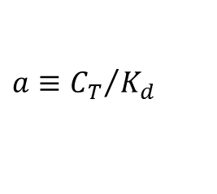
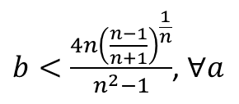
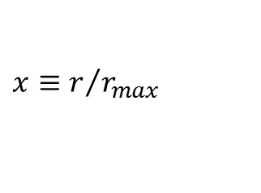
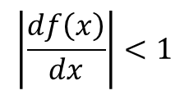


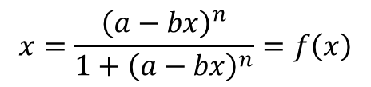

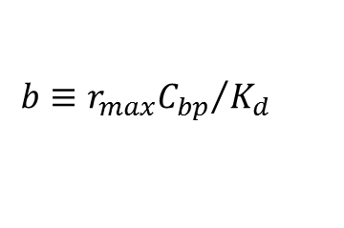
Solving Hill equation iteratively
Equation has a single-fixed point solution
Experimentally we know the total ligand concentration $C_{T}$ but not the free ligand concentration $C_{f}$. Since $C_{f}=C_{T}−C_{b}=C_{T}−{rC}_{bp}$ then,
$$a=1 b=0.5$$
$H\left(C_{f}\right)=H\left[C_{T}−{rC}_{bp}\right]=H\left[C_{T}−{r_{max}C}_{bp}H\left(C_{f}\right)\right]$
a) zeroth-order solution:
$$H\left(C_{f}\right)≅H\left[C_{T}\right]$$
b) first-order solution:
$$H\left(C_{f}\right)≅H\left[C_{T}−{r_{max}C}_{bp}H\left(C_{T}\right)\right]$$
$$x≡r/{r_{max}}$$
$$a≡{C_{T}}/{K_{d} }$$
$$x=\frac{{\left(a−bx\right)}^{n}}{1+{\left(a−bx\right)}^{n}}=f\left(x\right)$$
$$b≡{r_{max}C_{bp}}/{K_{d}}$$
Iterative solution possible if
$$\left|\frac{df\left(x\right)}{dx}\right|<1$$
$b<\frac{4n{\left(\frac{n−1}{n+1}\right)}^{\frac{1}{n}}}{n^{2}−1}$, $∀a$
then

Slide 23
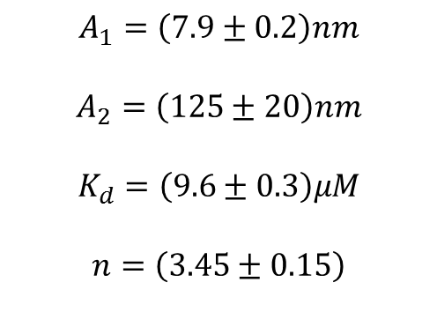
Cationic CD-DNA interaction
Fit using our model with first-order Hill equation
$$A_{1}=\left(7.9±0.2\right)nm$$
$$A_{2}=\left(125±20\right)nm$$
$$K_{d}=\left(9.6±0.3\right)μM$$
$$n=\left(3.45±0.15\right)$$

Slide 24
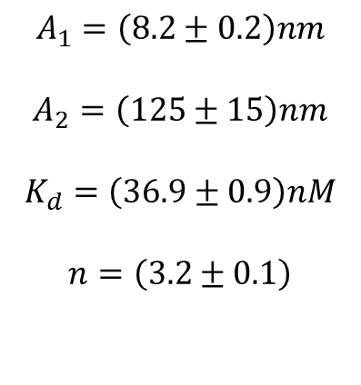
HU-DNA interaction
Fit using our model with a zeroth-ordem Hill equation
Data from J. van Noort et al., PNAS 101 (18), 6969 (2004)
$$A_{1}=\left(8.2±0.2\right)nm$$
$$A_{2}=\left(125±15\right)nm$$
$$K_{d}=\left(36.9±0.9\right)nM$$
$$n=\left(3.2±0.1\right)$$

Slide 25
Conclusions
We can study DNA interactions with ligands by measuring the persistence length and contour length of the complexes formed, using optical tweezers in single-molecule assays.
Interaction between DNA and beta-cyclodextrin and between HU-DNA cause non-monotonic persistence length behavior, indicating that for low ligand concentration the complex formed is more flexible and for higher concentrations more rigid.
We propose a two-sites quenched disorder statistical model together with Hill cooperativity, which provides a model function which fits very well both sets of data. Our model predicts that the binding kinetics is mediated by size stabilized bound-clusters. With the quantitative parameters obtained we were able to propose a microscopic physical mechanism for the CD-DNA cooperative binding.
Therefore, from a single mechanical measurement we can obtain the elastic parameters related to structural changes of the DNA molecule caused by the ligands, together with the chemical parameters of the binding reaction.

