Slide 1

Atividades de PDIT-IFSC/USP
Carlos Egues
Presidente da Comissão de Pequisa/IFSC

Slide 2
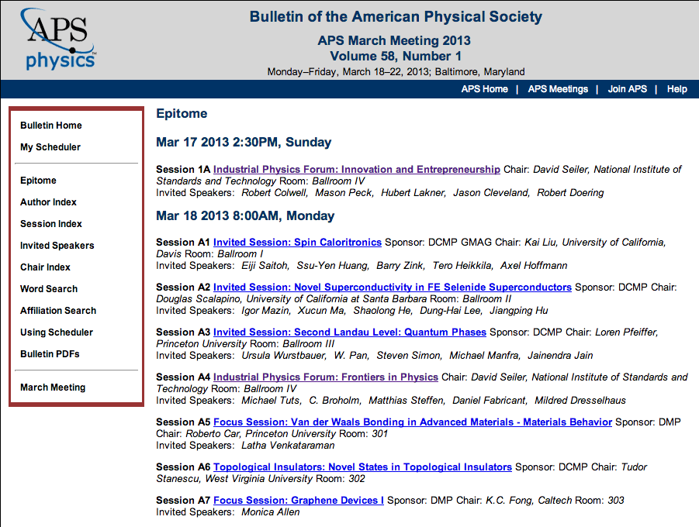

Slide 3
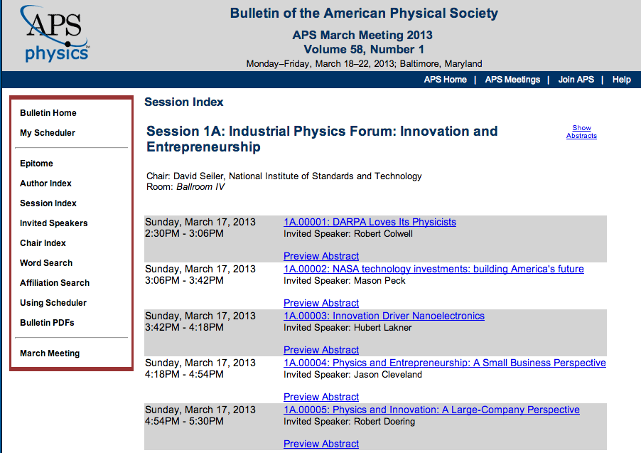

Slide 4
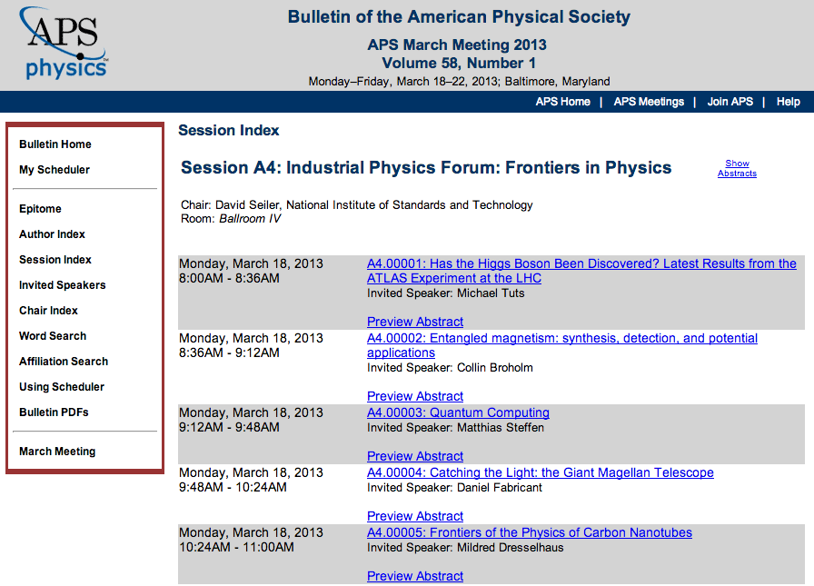

Slide 5
Crystal Growth and Ceramic Materials Group
Antonio C. Hernandes, Marcello R. B. Andreeta, José P. Andreeta,
Maria I.B. Bernardi
IFSC - Universidade de São Paulo - USP

Slide 6
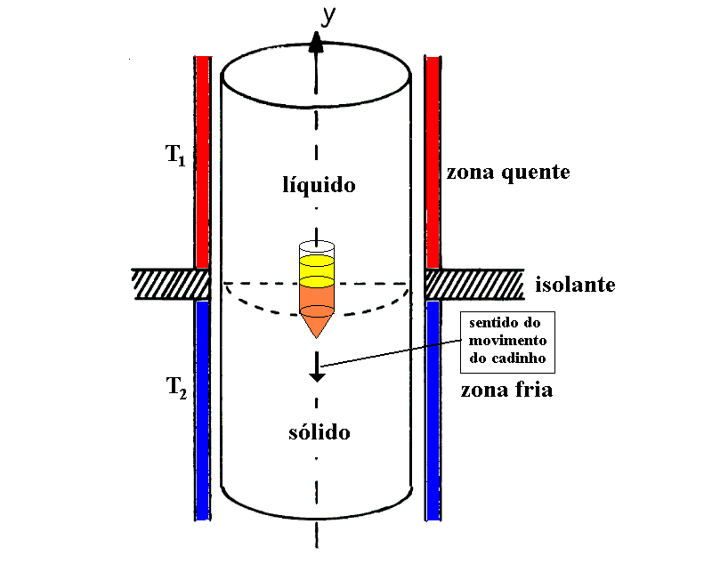
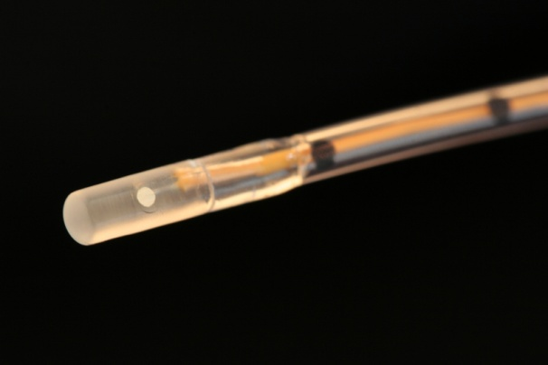
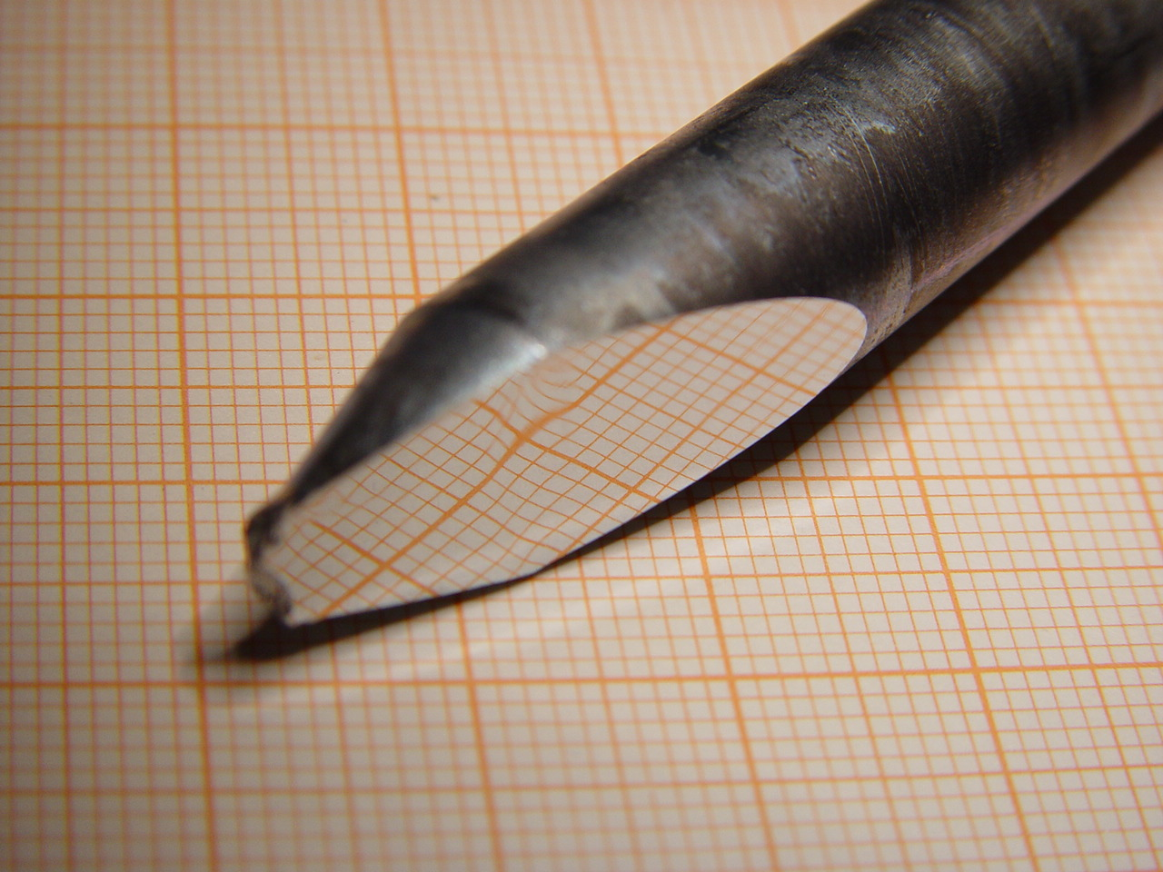
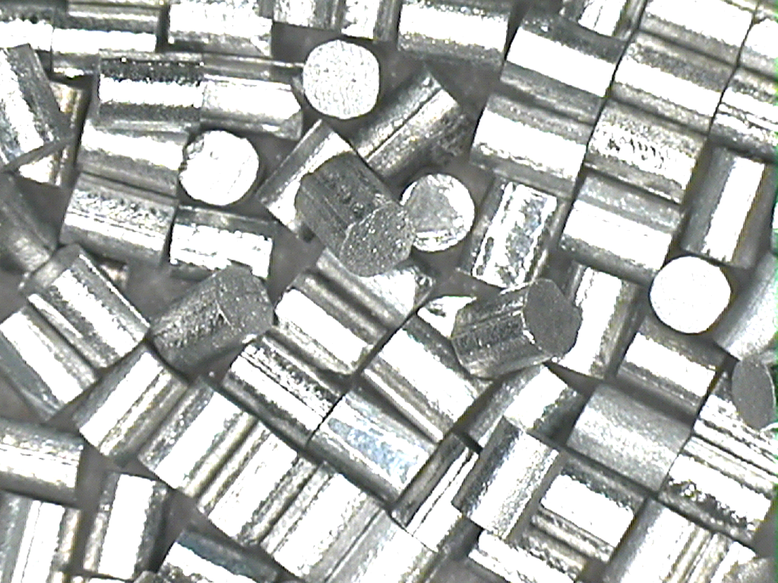
Sensor for Esophageal pH monitoring
Antimony single crystal
Liquid
Hot Zone
Cold Zone
Round antimony
single crystal
(patent pending)
Solid
Bridgmann Crystal
GrowthTechnique
pH sensor Tip
Problem: to develop
tecnhology (nat.) – sensor.
Innovation: to grow submillimeter Sb crystals.
Patente 77
This technology was transferred to Alacer Biomedica company.

Slide 7
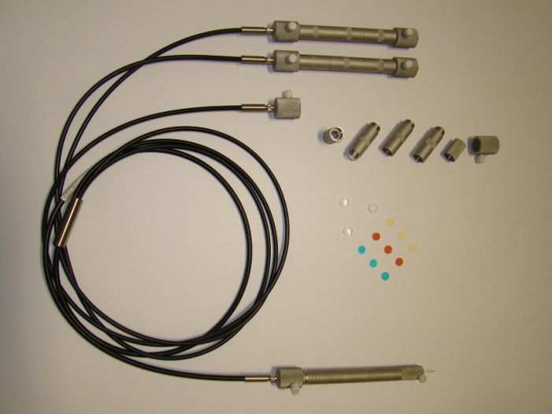
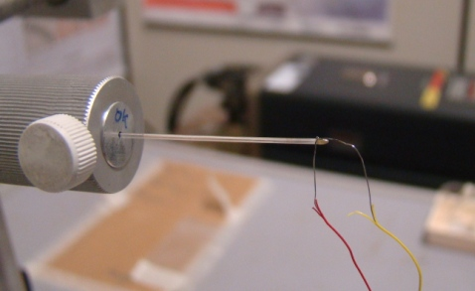
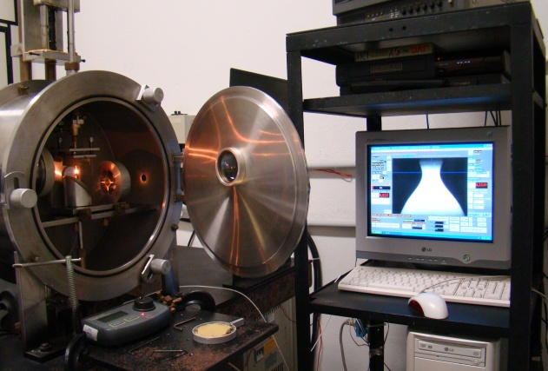
Laser thermotherapy system
Operation Principle
Optical fiber
Diode laser
Optical Coupler
810 nm
Optical fiber
Optical Coupler
Laser-Heated Pedestal Growth
laboratories at CCMC-IFSC-USP
Single crystal fiber
Hot Nd³⁺doped fiber tip
Photograph of the laser thermotherapy
system under development at IFSC-USP
Technology under development.

Slide 8
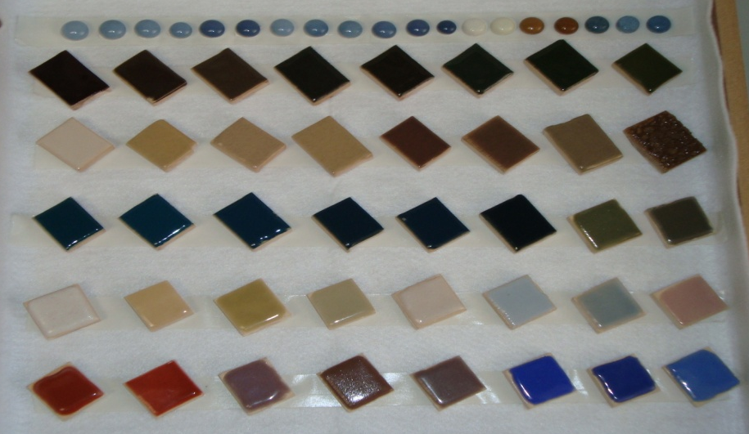
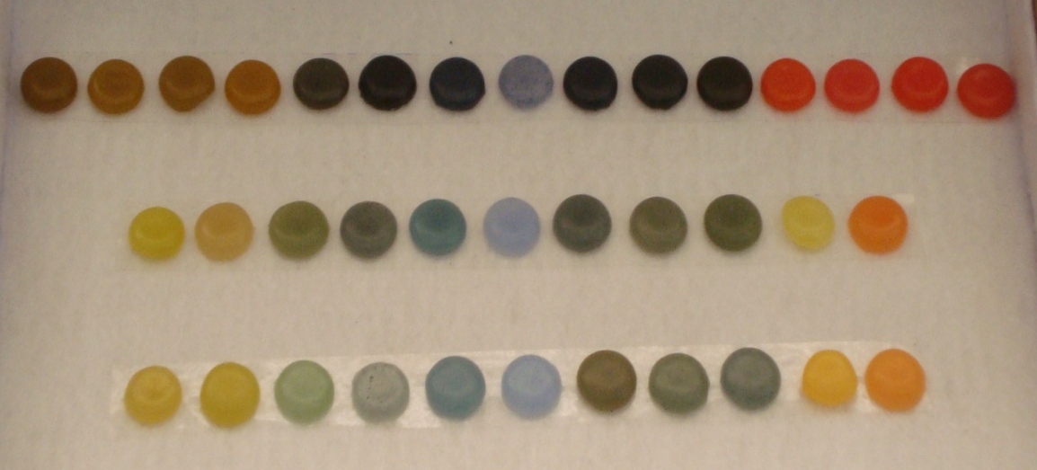
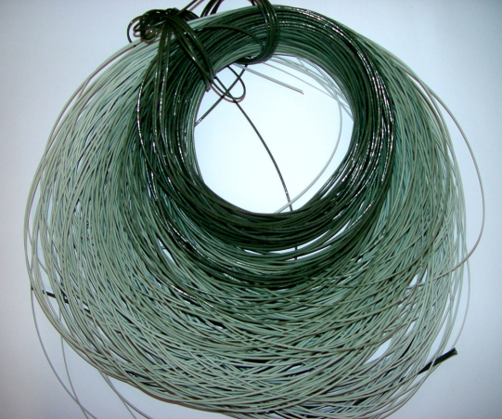
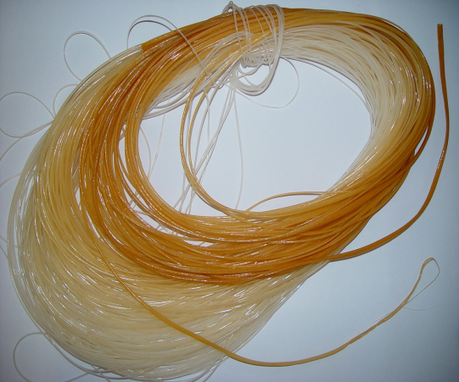
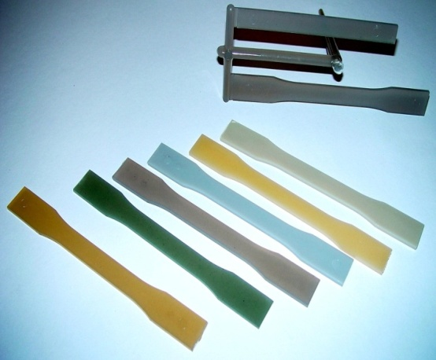
Nanoparticle pigments
Composite Materials
(Sta Gertrudes)
Composite Ceramics: Ceramics + Polymers
(PIPE FAPESP)
Technology transferred to COPOL.

Slide 9
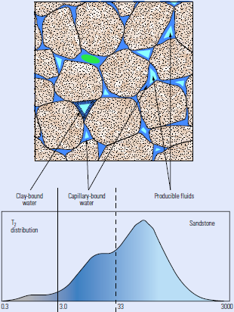
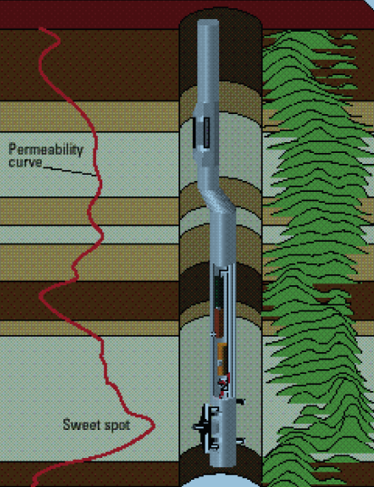
LEAR/NMR Group: Oil Science NMR / Well-Logging vs. Lab
NMR
Transverse relaxation, T₂
Longitudinal relaxation, T₁
Translational Diffusion, D
NMR
Pre-salt
Pore size
Permeability? NMR!
Clay-bound
fluids
Capillary-bound
fluids
Producible
fluids
NMR Well-Logging
Drilling tool…
T₂ distribution
Sandstone
30%
http://vimeo.com/19051493
Transverse relaxation, T₂ (ms)
http://geopoliticadopetroleo.files.wordpress.com/2010/03/img_plataforma-petrobras.jpg
www.slb.com/services/characterization/wireline_open_hole/nmr/
http://www.slb.com/services/characterization/wireline_open_hole/nmr/combinable_magnetic_resonance/combinable_magnetic_mdt.aspx

Slide 10
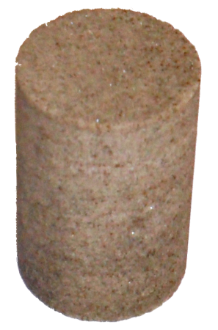
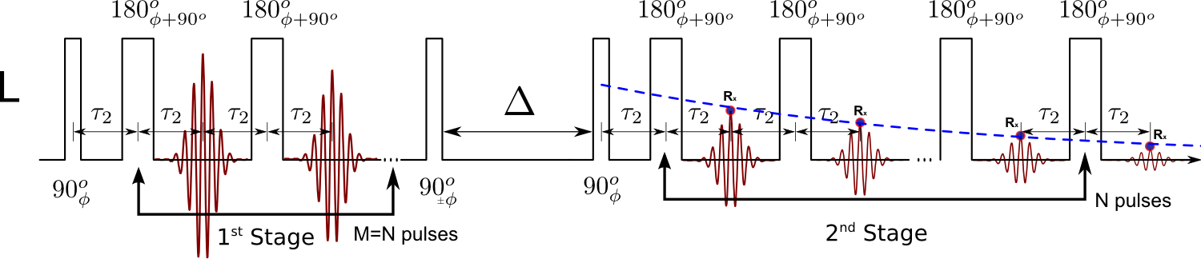
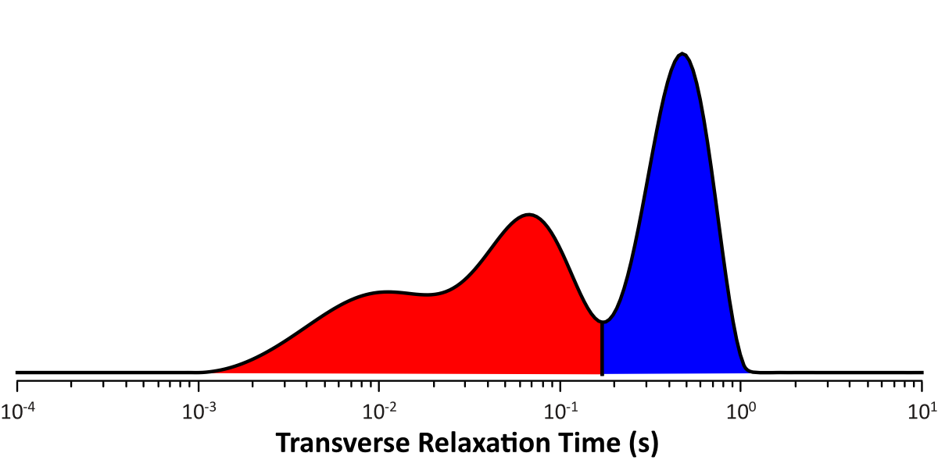
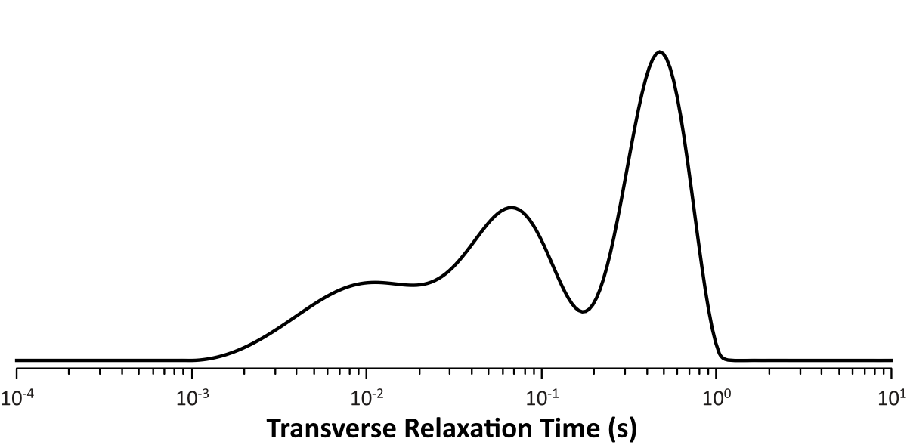
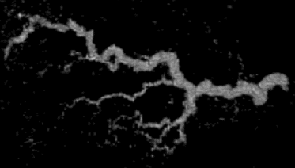
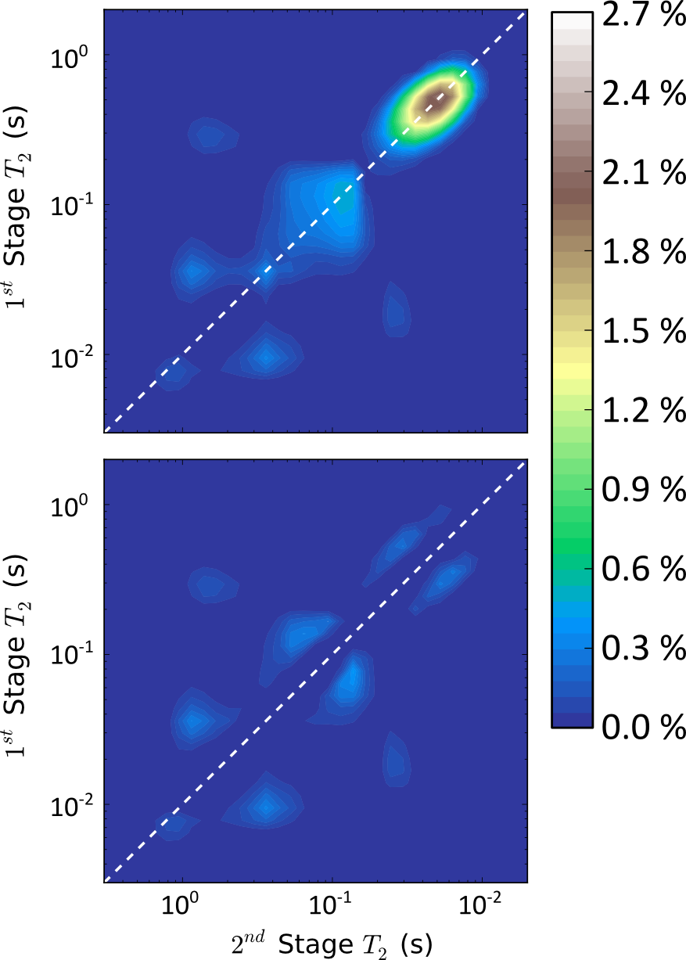
New NMR methods: relaxation times (permeability),
diffusion coefficients, Imaging (MRI)…
Pore sizes
(1 to 100 μm)
D
C
A
B
MRI
Permeability
~1 mm
D
C
AB
B
A
“Worm holes
AB
10⁻²
10⁻¹
10⁰
Petrobras & Schlumberger… (2 Ph.D.’s)
(“innovation in methodology”)
Visit our posters…

Slide 11
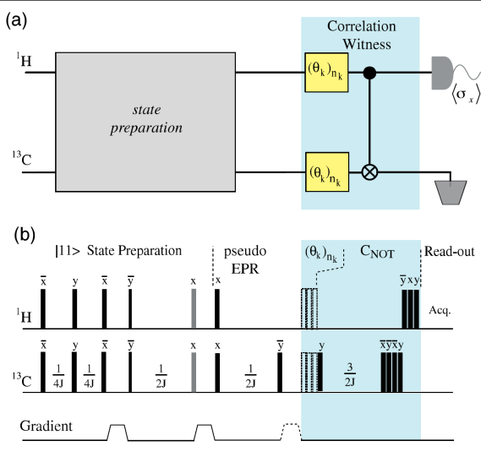
NMR in Quantum Computing
Experiments for Quantum Information Processing
NMR pulse sequence for implementing a quantum circuit designed to detect and quantify quantum correlations of separable states (quantum discord) [Physical Review Letters, 2011/2012].

Slide 12
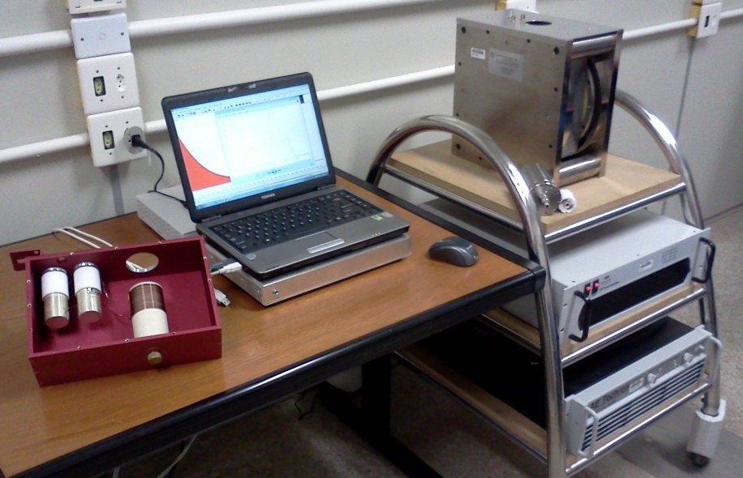
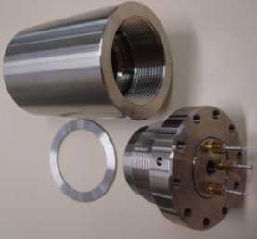
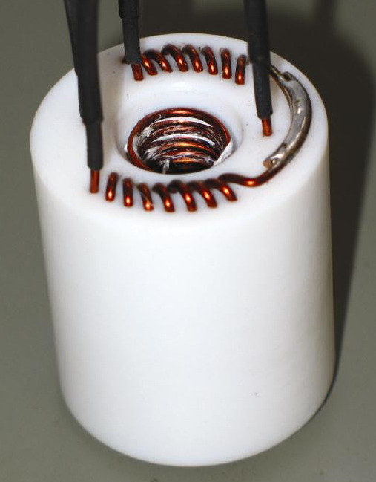
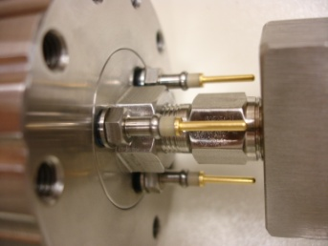
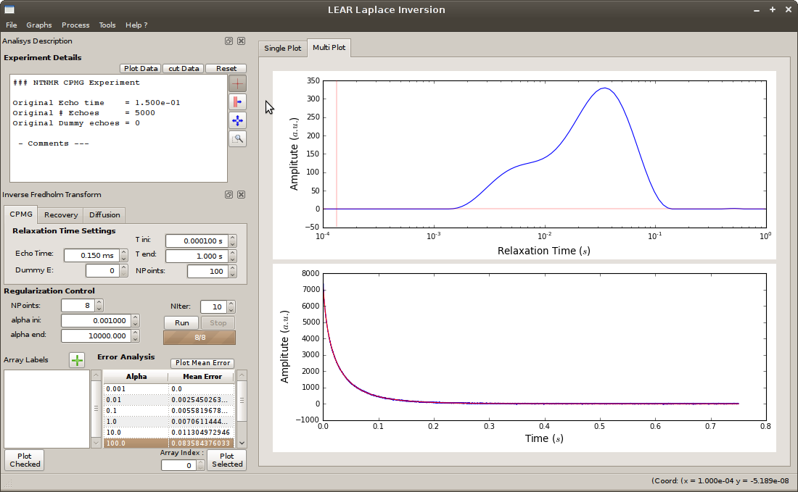
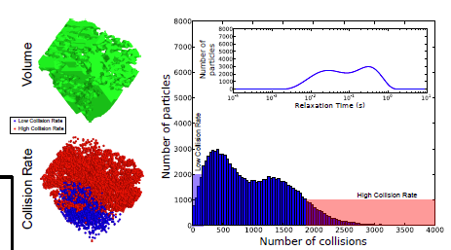
NMR hardware & software…
Permanent
magnet
NMR Spectrometer for
applications in oil science:
Partnership with Tecmag…
rf & magnetic
field gradient coils
High
Pressure
cell
(porous media in general!)
NMR accessories:
probes with rf & magnetic
field gradient coils under
reservoir conditions: ~10.000 psi & ~150 ºC
NMR probe
NMR software: Inverse Laplace transform, Numeric simulations, Spectrometer control…
INPI
Visit our posters & NMR stand…

Slide 13
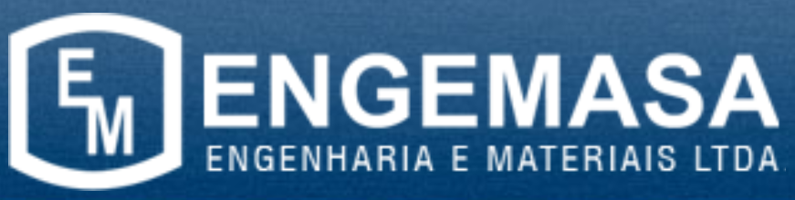
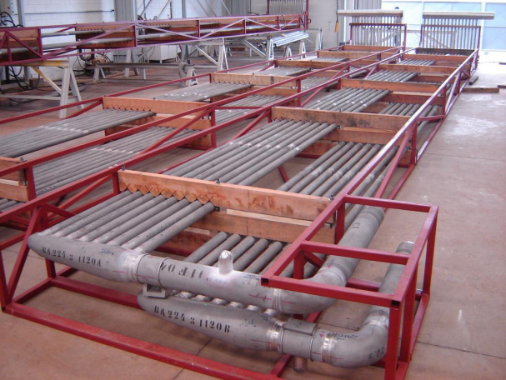
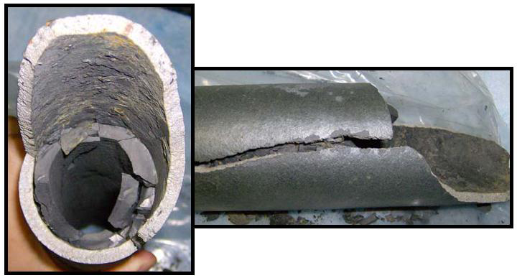

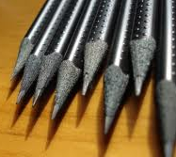

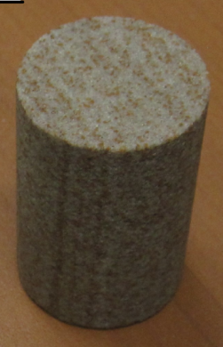

LEAR Collaboration Portfolio...
Steel
Carburization
process…
1 Ph.D. student from the Company: Physics/Metallurgy
1 Ph.D. student from the LEAR/NMR Group: Physics/Instrumentation
Industrial heat treatment for improving wood/pencil properties
1 Ph.D. student from the
LEAR/NMR Group:
Physics/NMR/Instrumentation
NMR methods, instrumentation,
numerical simulation, signal processing, ….
1 Ph.D. student from the Company: Petrophysics/NMR
6 Ph.D. & 2 M.Sc. students from
The LEAR/NMR Group:
Physics/NMR/Instrumentation/
Simulation…
1 Ph.D. student from the Company: Petrophysics/NMR
Visit our posters & NMR stand…

Slide 14
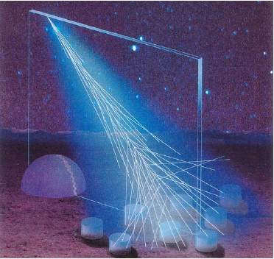
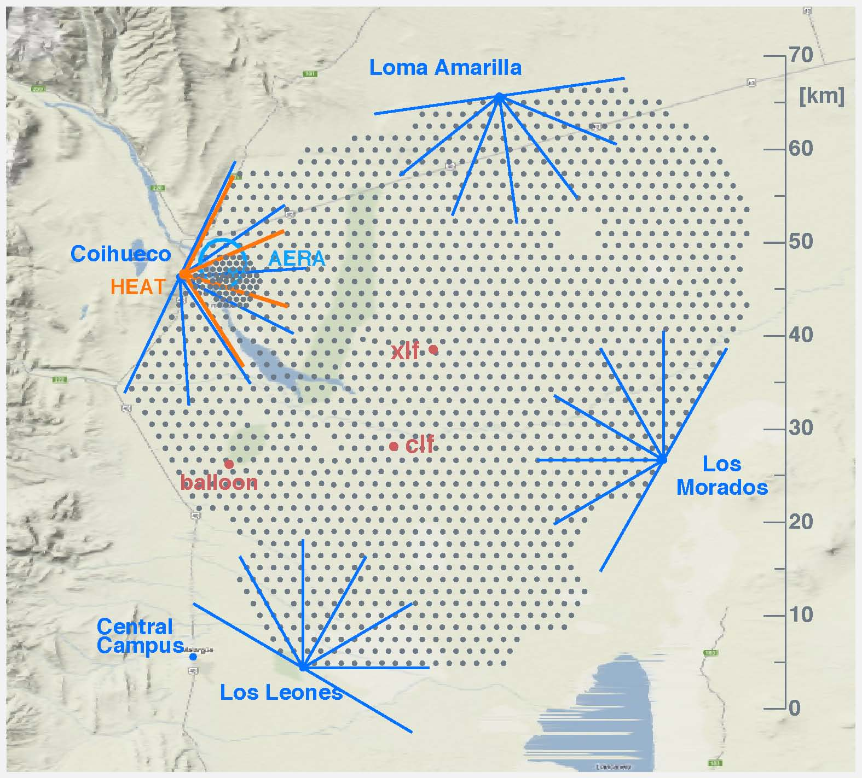
Pierre Auger Observatory
1600 ground detector and 27 telescopes

Slide 15
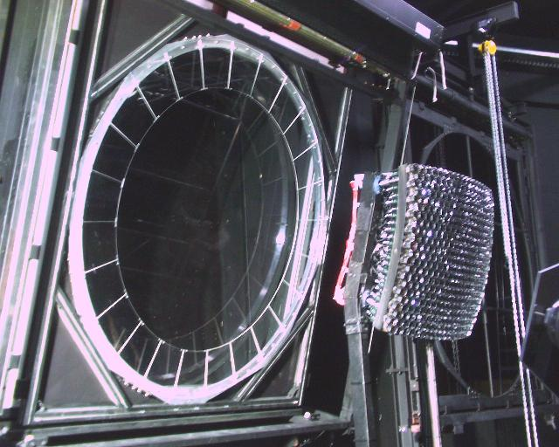
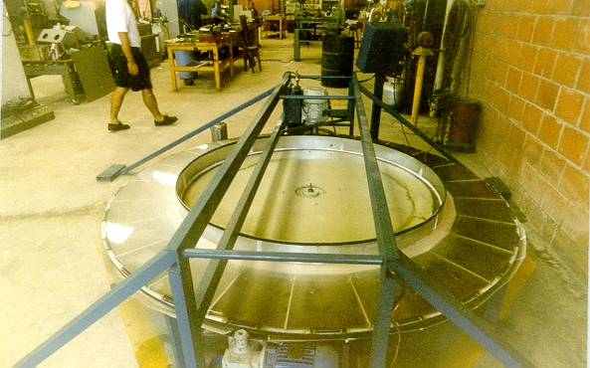
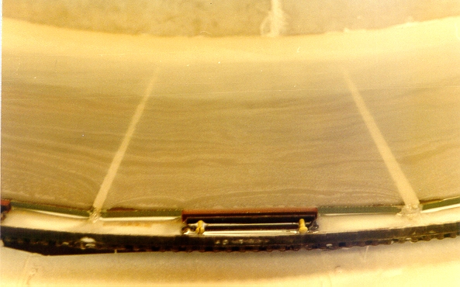
Pierre Auger Observatory
27 Corrector Lenses:
2.2 m diameter
done in Indaiatuba

Slide 16
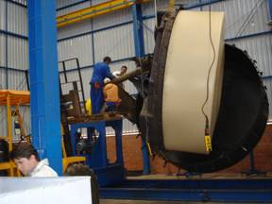
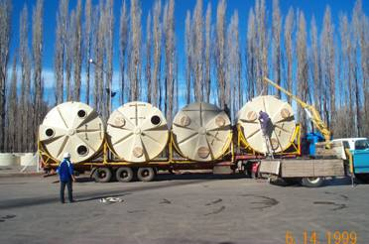
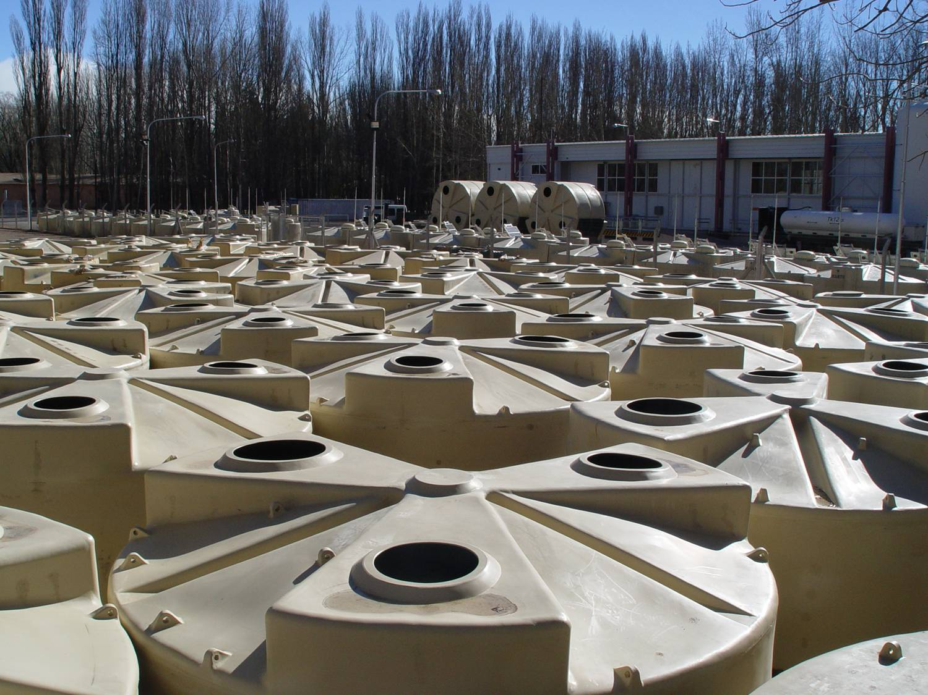
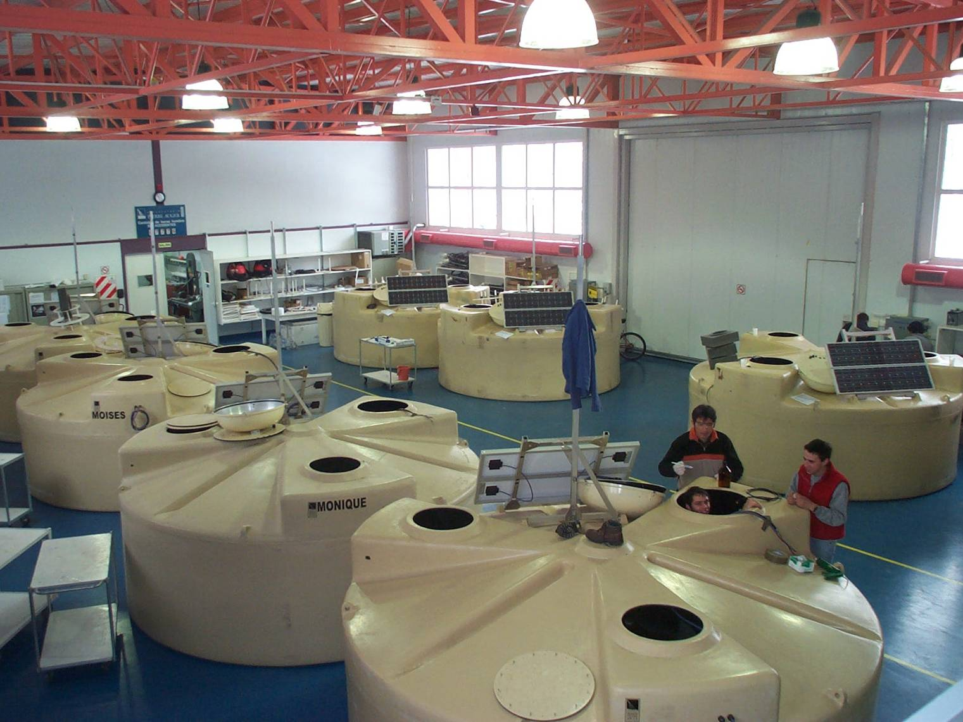
1000 ground detectors made in Brasil

Slide 17
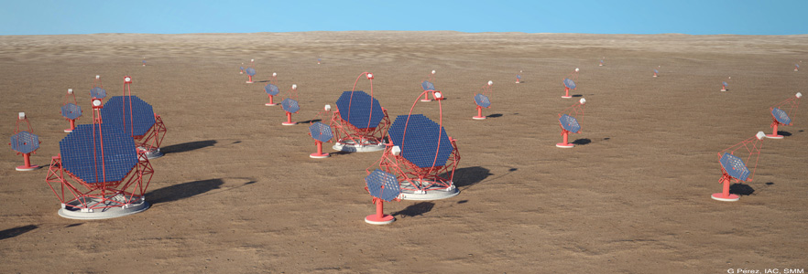
CTA Observatory
Most promissing astroparticle physics experiment for the next decade.
100 telescope to be built

Slide 18

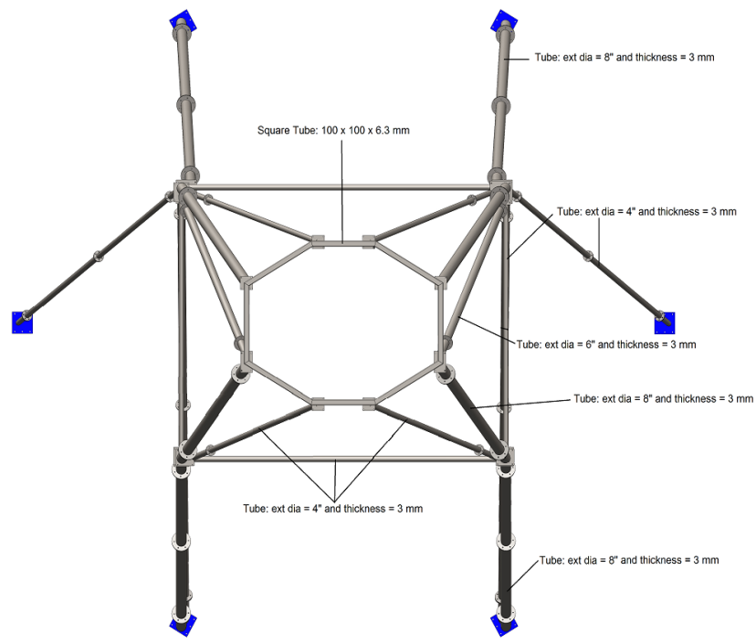

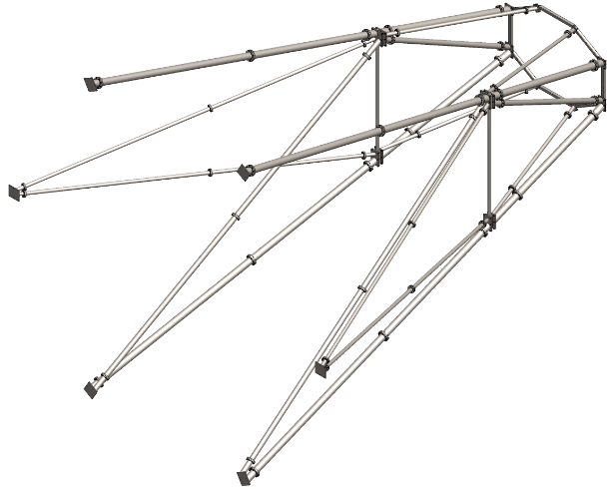
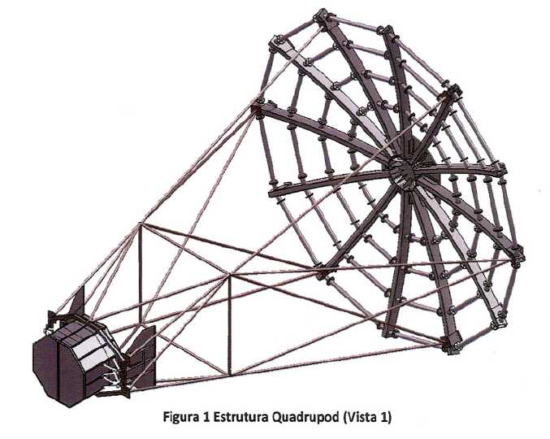
Developing structures for the telescope
(high precision mechanics)

Slide 19
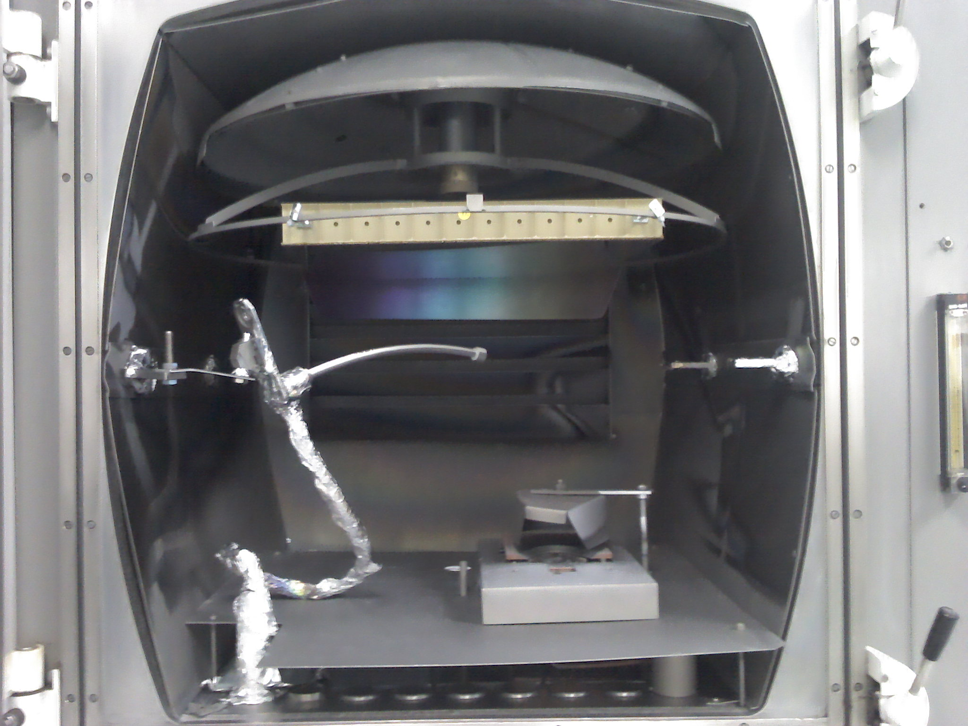

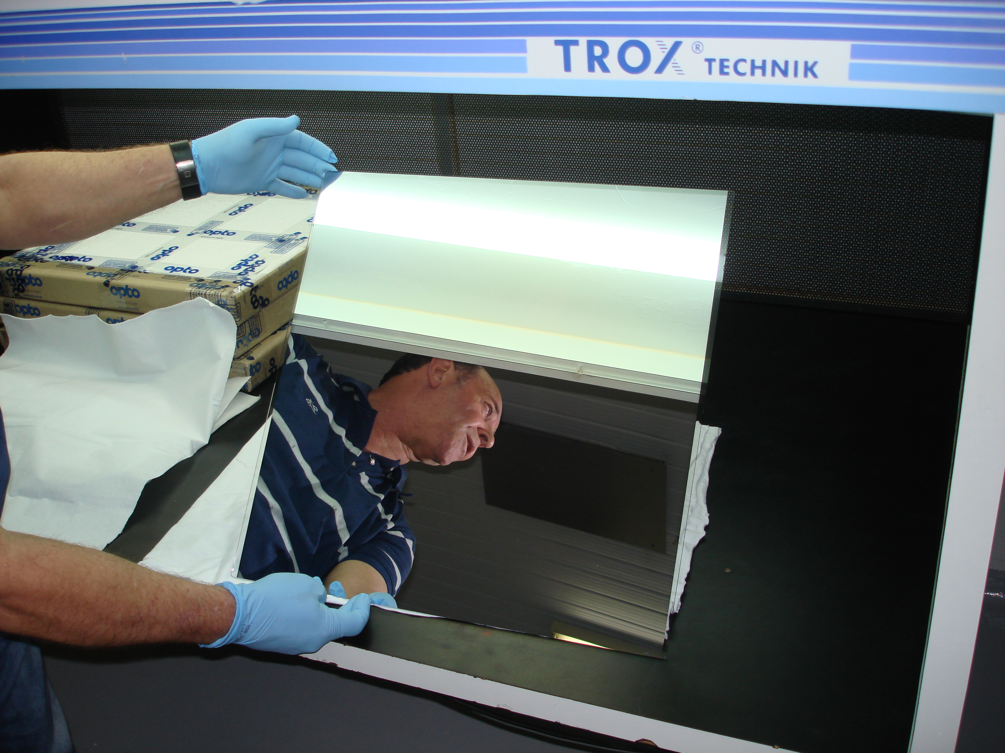

(projeto FAPESP)
Developing mirrors

Slide 20












Research topics of Biophotonics Lab
Photodynamic therapy - Cancer
Other phototherapies
Fundamentals of light / biological systems (cell-tissue) interaction
Optical diagnostics
Photodynamic therapy – Infectious disease
(customized instrumentation)
http:cepof.ifsc.usp.br

Slide 21





Innovation activities of Grupo de Óptica
Biomedical Interest
Development of optical techniques for diagnostics and treatment in Life Sciences (cancer, infectious disease, physical performance, environment)
Biomedical instrumentation for clinical applications and experimental research
(Prototype: uterine cancer; MM optics – Trubios/USA (trials)
Partnership with enterprises
Photodiagnosis and photodynamic therapy for the treatment of non-melanoma skin cancer
Photodynamic therapy for the inactivation of microorganisms
Digital X-ray
Ultrasonics scalpel
Patent applications: 42
http:cepof.ifsc.usp.br

Slide 22





Research at Nanomedicine and Nanotoxicology Lab LNN-IFSC-USP
Prof. Valtencir Zucolotto
zuco@ifsc.usp.br
www.nanomedicina.com.br
www.twitter.com/nanomedicina
Current Research Lines at LNN
Nanomedicine: Theranostic Nanomaterials for Cancer Therapy
Superparamagnetic Nanoparticles and Nanorods for NMR Imaging
Nanotoxicology Investigation
Biosensors for Infectious Diseases
Synthesis and Manipulation of Nanomaterials
Nanostructured Genosensors for early Detection of Genetic Diseases
Nanofibras
Nanorods
Nanopartículas
(TEM)
www.nanomedicina.com.br

Slide 23



1. Nanomedicine Applied to Diagnosis and Therapy: Nanocomplexes for Cancer Detection
Functionalization of FeFe2O4 and Au NPs with specific proteic ligands for targeting cancer cells
(bio tagging)
Tumors Cells Targeted with Nanoparticles
Au Nanocomplexes
MR Imaging
MagnetoHyperthermia
Strategies
Photothermia
(“contrast”)
Delivery

Slide 24


2. Nanotoxicology Studies
Cytotoxicity and Genotoxicity of AuNPs against Peripheral Blood Mononuclear Cells- PBMC
MTT assay-24 h incubation
Biomimetic Membranes Applied to Nanotoxicity Studies

Slide 25
3. Biosensors for Infectious Diseases
(chips para dignóstico rápido
& baixo custo)
(antigeno-anticorpo int. ->
const. dielétrica -> C)
Detection and Separation of L. amazonensis (positive) and T. cruzi (negative) Antibodies
Pat. Req. 2010

Slide 26

5. Spin-Off
Empresa start-up
Spin-off fundada em 2012 no Laboratório de Nanomedicina e Nanotoxicologia / IFSC-USP
Incubada no ParqTec (Parque Tecnológico de São Carlos)
Parceria com a Universidade: IFSC, IQSC, etc
Cosméticos, farmacêuticos, biotecnológicos, agrícola e veterinária
(projeto PIPE FAPESP)

Slide 27
5. Spin-Off
Empresa start-up
Spin-off fundada em 2012 no Laboratório de Nanomedicina e Nanotoxicologia / IFSC-USP
Incubada no ParqTec (Parque Tecnológico de São Carlos)
Parceria com a Universidade: IFSC, IQSC, etc
Cosméticos, farmacêuticos, biotecnológicos, agrícola e veterinária
Empresa voltada para o desenvolvimento de nanopartículas para liberação controlada de princípios ativos cosméticos (proteínas, colágeno, etc) ou de interesse no agronegócio (inseticidas e carrapaticidas verdes, baseados em óleos e extratos vegetais). Há tb pesquisa básica (físico-química), principalmente no design e caracterização dos nanoprodutos.
(projeto PIPE FAPESP)

Slide 28












  Structural Biology
  Medicinal Chemistry and Drug Design
  X-Ray Diffraction
  Molecular Targets (Proteins and Enzymes)
  Biochemical Investigation
  Crystallographic Structure
  Protein-Ligand Complexes
  Structure-Based Drug Design
  Design of Drug Candidates
Genome and Transcriptome

Slide 29




NEGLECTED TROPICAL DISEASES
3D TARGET STRUCTURE
BINDING CAVITY ANALYSIS
SUBSITES: S1, S2, S3 and S1’
DRUG DESIGN STRATEGIES

Slide 30















STRUCTURE- AND LIGAND-BASED DRUG DESIGN
SCREENINGS
PROTEIN PURIFICATION
BIOLOGICAL ASSAYS
BIOCHEMICAL ASSAYS
LEAD OPTIMIZATION
STRUCTURE-BASED DRUG DESIGN LIGAND-BASED DRUG DESIGN

Slide 31









ANTICANCER DRUG DISCOVERY
CELL-BASED ASSAYS
WOUND HEALING ASSAY
0h
Test Compound
Test Solution
10 µM
37°C, 5% CO₂, 22h

Slide 32



ANTICANCER DRUG DISCOVERY
CELL-BASED ASSAYS
BOYDEN CHAMBER MIGRATION ASSAY
Incubation 22h, 37ºC
5% de CO₂

Slide 33

ANTICANCER DRUG DISCOVERY
CELL-BASED MICROSCOPY ASSAYS

Slide 34













Crystal engineering
Molecules Materials Medicines
for Neglected Diseases
A global partnership between industry, government and academic researchers to create a new paradigm for improved medicines through solid-state Technology
Exploit solid-state Technology = more drug candidates
Novel crystal forms = tailored physicochemical properties
INNOVATE
SOLUBILITY
Improve
Bioavailability
Control
pharmacokinetics
Crystal Engineering
COMPOSITION
e-mail: molmatmed@gmail.com
www2.fisica.ufc.br/ayala/m3nd
Increase efficacy of
NCEs and existing APIs
Intellectual
Property

Slide 35
Solid State Technology for Better Medicines

Slide 36



Brazilian e-tongues
Pioneer in the use of information visualization for sensing and biosenging
Perinotto et al., Anal. Chem. – 2010
Paulovich et al., Anal. Bioanal. Chem. 2011

Slide 37



Morphology of the sugar cane cell wall
Acid treated
Untreated
Rezende, et al. & Igor Polikarpov “Chemical and morphological characterization of sugarcane bagasse submitted to delignification process for enhanced enzymatic digestibility” Biotechnology for Biofuels (2011) 4:54
Alkali treated

Slide 38

Sao Paulo State – Bionergy Program
FAPESP (Bioen Program)
São Paulo State
FAPESP (Bioen Program)
Infrastructure
Research grants
USP BIOENERGY PROGRAM
Manpower
USP

Slide 39
Topological Insulators
(Buckley prize 2012)
CdTe
HgTe
Metallic surface
(or edge if 2D)
HgTe
CdTe
⇑
Energy (eV)
Gap closes
at interface
Gapless edge/surf. states:
localized at interface
‘robust’ (TR protected,
if single Kramers pair)
Crucial ingredient:
Spin orbit interaction (k.p)
Pankratov et al. ’85
Kane, Zhang, & Molenkamp
k (1/nm)
k (1/nm)

Slide 40
Obrigado aos colegas do IFSC pelas discussões e slides!

